Slide 1

Introduction to R
Brody Sandel

Slide 2
Topics
Approaching your analysis
Basic structure of R
Basic programming
Plotting
Spatial data

Slide 3
What is R?
R is a statistical programming language
  Written by statisticians/analysts for the same
  You can treat it like a command-line interface (like DOS)
  You can treat it more like a programming language (like C++)
What can it do?
  Data management
  Plotting
  Statistical tests
  Spatial data
  … anything else!

Slide 4
Before you type anything . . .
It is important to know where you want to go
  Understanding how to think about statistical programming is at least as important as learning R syntax
Get yourself set up properly
  A good text editor (Tinn-R, Rstudio, etc.)

Slide 5
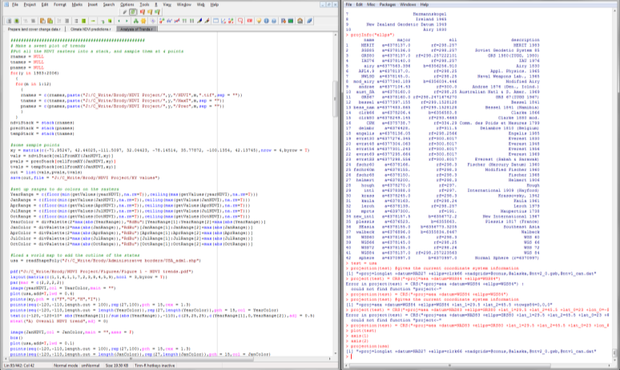
Working in R
Tinn-R
R

Slide 6
Working in R
Tinn-R
R
I do all of my work here
It is a record of everything I did
It lets me recreate my analysis later
Two kinds of scripts:
Exploratory (“stream of consciousness”)
Polished (“do one task and do it well”)
Most of the time scripts develop from exploratory to polished as a project develops

Slide 7
Working in R
Tinn-R
R
But don’t ignore this window either!
You should often look at your objects to make sure they look right!

Slide 8
Writing code
When you look at someone else’s script, it is easy to imagine that they started typing at the top and stopped at the bottom, like a book
They didn’t
I build up each line of code (usually) from the inside out, checking at each stage that it does what I think it should
Constant error checking is crucial
Look at your objects! Do they look right?

Slide 9
When and what should I save?
Always save your script
Sometimes write files (csv, raster, shapefile) to your hard drive as an output of your script
Rarely save an R object (using the save() function)
Rarely save a workspace (using file>save workspace)
As a project develops, I prefer to have several discrete scripts that each handle a particular job, rather than one big one

Slide 10
The structure of R
Objects
Functions
Control elements

Slide 11
The structure of R
Objects (what “things” do you have?)
Functions (what do you want to do to them?)
Control elements (when/how often do you want to do it?)

Slide 12
What is an object?
What size is it?
  Vector (one-dimensional, including length = 1)
  Matrix (two-dimensional)
  Array (n-dimensional)
What does it hold?
  Numeric (0, 0.2, Inf, NA)
  Logical (T, F)
  Factor (“Male”, “Female”)
  Character (“Bromus diandrus”, “Bromus carinatus”, “Bison bison”)
  Mixtures
    Lists
    Dataframes
class() is a function that tells you what type of object the argument is

Slide 13
Creating a numeric object
a = 10
a
[1] 10
a <- 10
a
[1] 10
10 -> a
a
[1] 10

Slide 14
Creating a numeric object
a = 10
a
[1] 10
a <- 10
a
[1] 10
10 -> a
a
[1] 10
All of these are assignments

Slide 15
Creating a numeric object
a = a + 1
a
[1] 11
b = a * a
b
[1] 121
x = sqrt(b)
x
[1] 11

Slide 16
Creating a numeric object (length >1)
a = c(4,2,5,10)
a
[1] 4 2 5 10
a = 1:4
a
[1] 1 2 3 4
a = seq(1,10)
a
[1] 1 2 3 4 5 6 7 8 9 10

Slide 17
Creating a numeric object (length >1)
a = c(4,2,5,10)
a
[1] 4 2 5 10
a = 1:4
a
[1] 1 2 3 4
a = seq(1,10)
a
[1] 1 2 3 4 5 6 7 8 9 10
Two arguments passed to this function!

Slide 18
Creating a numeric object (length >1)
a = c(4,2,5,10)
a
[1] 4 2 5 10
a = 1:4
a
[1] 1 2 3 4
a = seq(1,10)
a
[1] 1 2 3 4 5 6 7 8 9 10
This function returns a vector

Slide 19
Creating a matrix object
A = matrix(data = 0, nrow = 6, ncol = 5)
A
[,1] [,2] [,3] [,4] [,5]
[1,] 0 0 0 0 0
[2,] 0 0 0 0 0
[3,] 0 0 0 0 0
[4,] 0 0 0 0 0
[5,] 0 0 0 0 0
[6,] 0 0 0 0 0

Slide 20
Creating a logical object
3 < 5
[1] TRUE
3 > 5
[1] FALSE
x = 5
x == 5
[1] TRUE
x != 5
[1] FALSE
Conditional operators
< > <= >= == != %in% & |

Slide 21
Creating a logical object
3 < 5
[1] TRUE
3 > 5
[1] FALSE
x = 5
x == 5
[1] TRUE
x != 5
[1] FALSE
Very important to remember this difference!!!
Conditional operators
< > <= >= == != %in% & |

Slide 22
Creating a logical object
x = 1:10
x < 5
[1] TRUE TRUE TRUE TRUE FALSE
[6] FALSE FALSE FALSE FALSE FALSE
x == 2
[1] FALSE TRUE FALSE FALSE FALSE
[6] FALSE FALSE FALSE FALSE FALSE
Conditional operators
< > <= >= == != %in% & |

Slide 23
Getting at values
R uses [ ] to refer to elements of objects
For example:
  V[5] returns the 5th element of a vector called V
  M[2,3] returns the element in the 2nd row, 3rd column of matrix M
  M[2,] returns all elements in the 2nd row of matrix M
The number inside the brackets is called an index

Slide 24
Indexing a 1-D object
a = c(3,2,7,8)
a[3]
[1] 7
a[1:3]
[1] 3 2 7
a[seq(2,4)]
[1] 2 7 8

Slide 25
Indexing a 1-D object
a = c(3,2,7,8)
a[3]
[1] 7
a[1:3]
[1] 3 2 7
a[seq(2,4)]
[1] 2 7 8
See what I did there?

Slide 26
Just for fun . . .
a = c(3,2,7,8)
a[a]

Slide 27
Just for fun . . .
a = c(3,2,7,8)
a[a]
[1] 7 2 NA NA
When would a[a] return a?

Slide 28
Indexing a 2-D object
A = matrix(data = 0, nrow = 6, ncol = 5)
A
[,1] [,2] [,3] [,4] [,5]
[1,] 0 0 0 0 0
[2,] 0 0 0 0 0
[3,] 0 0 0 0 0
[4,] 0 0 0 0 0
[5,] 0 0 0 0 0
[6,] 0 0 0 0 0
A[3,4]
[1] 0
The order is always [row, column]

Slide 29
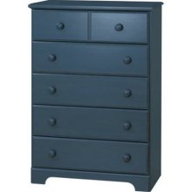
Lists
A list is a generic holder of other variable types
Each element of a list can be anything (even another list!)
a = c(1,2,3)
b = c(10,20,30)
L = list(a,b)
L
[[1]]
[1] 1 2 3
[[2]]
[3] 10 20 30
L[[1]]
[1] 1 2 3
L[[2]][2]
[1] 20

Slide 30
Data and data frames
Principles
  Read data off of hard drive
  R stores it as an object (saved in your computer’s memory)
  Treat that object like any other
  Changes to the object are restricted to the object, they don’t affect the data on the hard drive
Data frames are 2-d objects where each column can have a different class

Slide 31
Working directory
The directory where R looks for files, or writes files
setwd() changes it
dir() shows the contents of it
setwd(“C:/Project Directory/”)
dir()
[1] “a figure.pdf”
[2] “more data.csv”
[3] “some data.csv”

Slide 32
Read a data file
setwd(“C:/Project Directory/”)
dir()
[1] “a figure.pdf”
[2] “more data.csv”
[3] “some data.csv”
myData = read.csv(“some data.csv”)

Slide 33
Writing a data file
setwd(“C:/Project Directory/”)
dir()
[1] “a figure.pdf”
[2] “more data.csv”
[3] “some data.csv”
myData = read.csv(“some data.csv”)
write.csv(myData,”updated data.csv”)
dir()
[1] “a figure.pdf”
[2] “more data.csv”
[3] “some data.csv”
[4] “updated data.csv”

Slide 34
Finding your way around a data frame
head() shows the first few lines
tail() shows the last few
names() gives the column names
Pulling out columns
  Data$columnname
  Data[,columnname]
  Data[,3] (if columnname is the 3rd column)

Slide 35
Functions
Function
Object
Object

Slide 36
Functions
Object
Function
Object
Object
Object

Slide 37
Functions
Object
Function
Object
Object
Object
Options

Slide 38
Functions
Object
Function
Object
Object
Return
Object
Options
Arguments

Slide 39
Functions
Object
Function
Object
Object
Object
Options
Controlled by control elements (for, while, if)

Slide 40
Calling a function
Call: a function with a particular set of arguments
function( argument, argument . . . )
x = function( argument, argument . . .)
sqrt(16)
[1] 4
x = sqrt(16)
x
[1] 4

Slide 41
Calling a function
Call: a function with a particular set of arguments
function( argument, argument . . . )
x = function( argument, argument . . .)
sqrt(16)
[1] 4
x = sqrt(16)
x
[1] 4
The function return is not saved, just printed to the screen

Slide 42
Calling a function
Call: a function with a particular set of arguments
function( argument, argument . . . )
x = function( argument, argument . . .)
sqrt(16)
[1] 4
x = sqrt(16)
x
[1] 4
The function return is assigned to a new object, “x”

Slide 43
Arguments to a function
function( argument, argument . . .)
  Many functions will have default values for arguments
    If unspecified, the argument will take that value
  To find these values and a list of all arguments, do:
If you are just looking for functions related to a word, I would use google. But you can also:
?function.name
??key.word

Slide 44
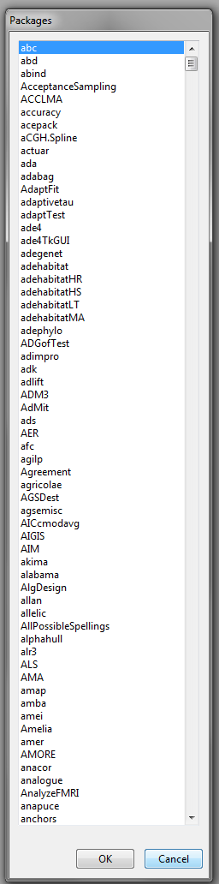
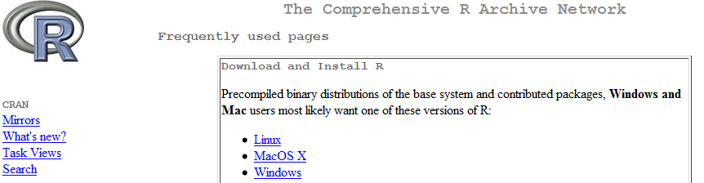
Packages
Sets of functions for a particular purpose
  We will explore some of these in detail
install.packages()
require(package.name)
CRAN!

Slide 45
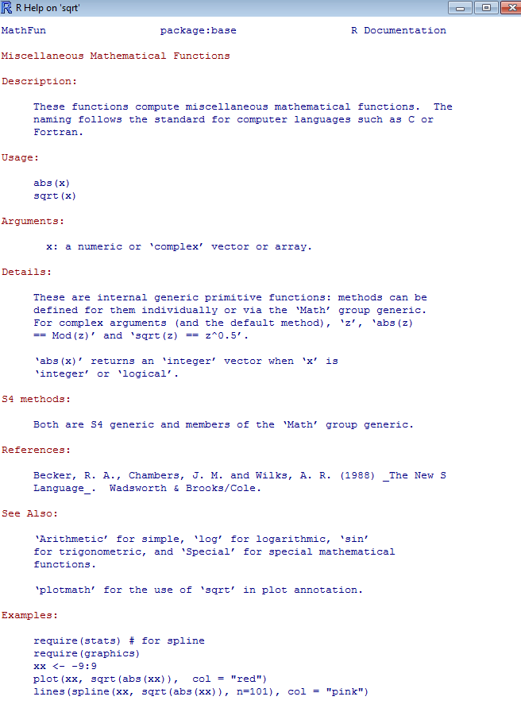
Function help
Syntax
Arguments
Return

Slide 46
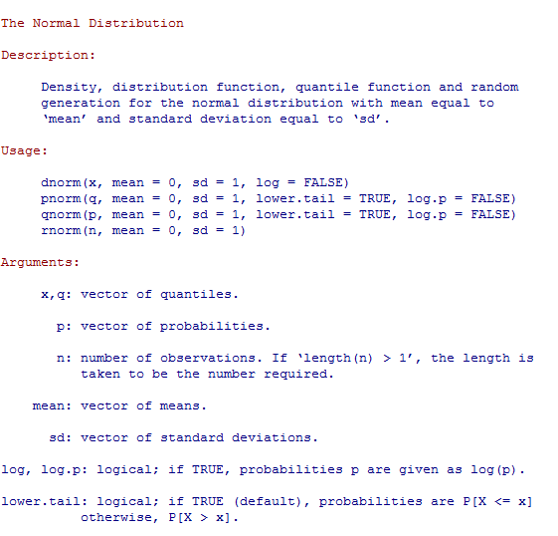
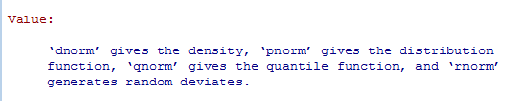
Function help

Slide 47
Programming in R
Functions
Loop

Slide 48
Programming in R
Functions
Loop
Functions
if
Output
Functions
Output
if
Output

Slide 49
Next topic: control elements
for
if
while
The general syntax is:
for/if/while ( conditions )
{
commands
}

Slide 50
For
When you want to do something a certain number of times
When you want to do something to each element of a vector, list, matrix . . .
X = seq(1,4,by = 1)
for(i in X)
{
print(i+1)
}
[1] 2
[1] 3
[1] 4
[1] 5

Slide 51
Details of for
for( i in 1:10 )

Slide 52
Details of for
for( i in 1:10 )
1
2
3
4
5
6
7
8
9
10

Slide 53
Details of for
for( i in 1:10 )
1
2
3
4
5
6
7
8
9
10
i = 1
Do any number of functions with i
print(i)
x = sqrt(i)

Slide 54
Details of for
for( i in 1:10 )
1
2
3
4
5
6
7
8
9
10
i = 2
Do any number of functions with i
print(i)
x = sqrt(i)

Slide 55
Details of for
for( i in 1:10 )
1
2
3
4
5
6
7
8
9
10
i = 10
Do any number of functions with i
print(i)
x = sqrt(i)

Slide 56
i as an Index
X = c(17,3,-1,10,9)
Y = rep(NA,5)
for(i in 1:length(X))
{
if(X[i] < 12)
{
Y[i] = X[i] + 5
}
}
X =
17
3
-1
10
9

Slide 57
i as an Index
X = c(17,3,-1,10,9)
Y = rep(NA,5)
for(i in 1:length(X))
{
if(X[i] < 12)
{
Y[i] = X[i] + 5
}
}
X =
17
3
-1
10
9
Y =
NA
NA
NA
NA
NA

Slide 58
i as an Index
X = c(17,3,-1,10,9)
Y = NULL
for(i in 1:length(X))
{
if(X[i] < 12)
{
Y[i] = X[i] + 5
}
}
X =
17
3
-1
10
9
Y =
NA
NA
NA
NA
NA
1
2
3
4
5
i = 1
(so X[i] = 17)

Slide 59
i as an Index
X = c(17,3,-1,10,9)
Y = NULL
for(i in 1:length(X))
{
if(X[i] < 12)
{
Y[i] = X[i] + 5
}
}
F
X =
17
3
-1
10
9
Y =
NA
NA
NA
NA
NA
1
2
3
4
5
i = 1
(so X[i] = 17)

Slide 60
i as an Index
X = c(17,3,-1,10,9)
Y = NULL
for(i in 1:length(X))
{
if(X[i] < 12)
{
Y[i] = X[i] + 5
}
}
X =
17
3
-1
10
9
Y =
NA
NA
NA
NA
NA
1
2
3
4
5
i = 2
(so X[i] = 3)

Slide 61
i as an Index
X = c(17,3,-1,10,9)
Y = NULL
for(i in 1:length(X))
{
if(X[i] < 12)
{
Y[i] = X[i] + 5
}
}
T
X =
17
3
-1
10
9
Y =
NA
NA
NA
NA
NA
1
2
3
4
5
i = 2
(so X[i] = 3)

Slide 62
i as an Index
X = c(17,3,-1,10,9)
Y = NULL
for(i in 1:length(X))
{
if(X[i] < 12)
{
Y[i] = X[i] + 5
}
}
X =
17
3
-1
10
9
Y =
NA
8
NA
NA
NA
1
2
3
4
5
i = 2
(so X[i] = 3)

Slide 63
i as an Index
X = c(17,3,-1,10,9)
Y = NULL
for(i in 1:length(X))
{
if(X[i] < 12)
{
Y[i] = X[i] + 5
}
}
X =
17
3
-1
10
9
Y =
NA
8
4
15
14
1
2
3
4
5

Slide 64
i as an Index
X = c(17,3,-1,10,9)
Y = NULL
for(i in 1:length(X))
{
if(X[i] < 12)
{
Y[i] = X[i] + 5
}
}
X =
17
3
-1
10
9
Y =
NA
8
4
15
14
1
2
3
4
5
This vector (created by the for) indexes vectors X and Y

Slide 65
2-dimension equivalent
X = matrix(1:6,ncol = 2,nrow = 3)
Y = matrix(NA,ncol = 2,nrow = 3)
for(i in 1:nrow(X))
{
for(j in 1:ncol(X))
{
Y[i,j] = X[i,j]^2
}
}
1
4
NA
NA
X =
2
5
Y =
NA
NA
3
6
NA
NA

Slide 66
2-dimension equivalent
X = matrix(1:6,ncol = 2,nrow = 3)
Y = matrix(NA,ncol = 2,nrow = 3)
for(i in 1:nrow(X))
{
for(j in 1:ncol(X))
{
Y[i,j] = X[i,j]^2
}
}
i j
1
4
NA
NA
X =
2
5
Y =
NA
NA
3
6
NA
NA

Slide 67
2-dimension equivalent
X = matrix(1:6,ncol = 2,nrow = 3)
Y = matrix(NA,ncol = 2,nrow = 3)
for(i in 1:nrow(X))
{
for(j in 1:ncol(X))
{
Y[i,j] = X[i,j]^2
}
}
i j
1
4
1
NA
1
1
X =
2
5
Y =
NA
NA
3
6
NA
NA

Slide 68
2-dimension equivalent
X = matrix(1:6,ncol = 2,nrow = 3)
Y = matrix(NA,ncol = 2,nrow = 3)
for(i in 1:nrow(X))
{
for(j in 1:ncol(X))
{
Y[i,j] = X[i,j]^2
}
}
i j
1
4
1
16
1
1
2
1
2
1
X =
2
5
Y =
4
NA
3
6
NA
NA

Slide 69
2-dimension equivalent
X = matrix(1:6,ncol = 2,nrow = 3)
Y = matrix(NA,ncol = 2,nrow = 3)
for(i in 1:nrow(X))
{
for(j in 1:ncol(X))
{
Y[i,j] = X[i,j]^2
}
}
i j
1
4
1
16
1
1
2
2
3
3
1
2
1
2
1
2
X =
2
5
Y =
4
25
3
6
9
36

Slide 70
If
When you want to execute a bit of code only if some condition is true
X = 25
if( X < 22 )
{
print(X+1)
}
X = 20
if( X < 22 )
{
print(X+1)
}
[1] 21
< > <= >= == != %in% & |

Slide 71
If/else
Do one thing or the other
X = 10
if( X < 22 )
{
X+1
}else(sqrt(X))
[1] 11
X = 25
if( X < 22 )
{
X+1
}else(sqrt(X))
[1] 5
< > <= >= == != %in% & |

Slide 72
While
Do something as long as a condition is TRUE
i = 1
while( i < 5 )
{
i = i + 1
}
i
[1] 5
< > <= >= == != %in% & |

Slide 73
End of first lecture
Try it out!

