Slide 1

Plotting and spatial data
Brody Sandel

Slide 2
Plotting
For creating a plot
  plot()
  hist()
For drawing on a plot
  points()
  segments()
  polygons()
For controlling how plots look
  par()
Make a new plotting window
  x11() (PC), quartz() (Mac)

Slide 3
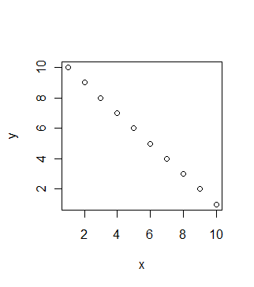
plot()
x = 1:10
y = 10:1
plot(x,y)

Slide 4
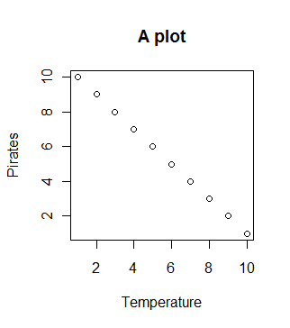
plot()
x = 1:10
y = 10:1
plot(x,y,main = “A plot”,xlab = “Temperature”,
ylab = “Pirates”)

Slide 5
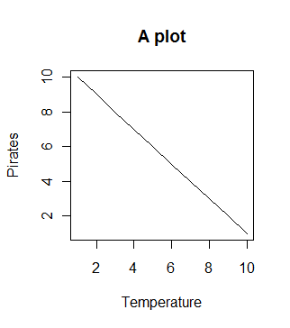
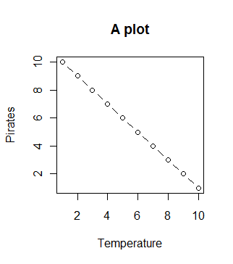
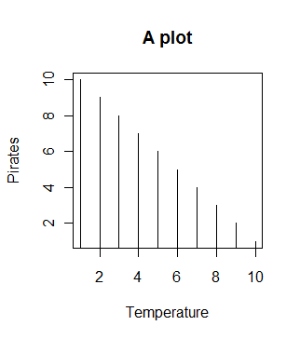
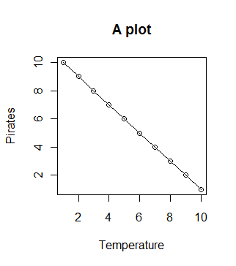
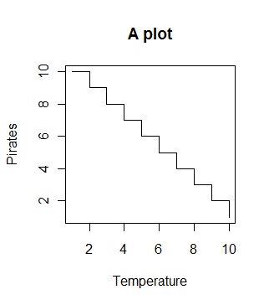
type =
“l” “b” ”h”
“o” “s”

Slide 6
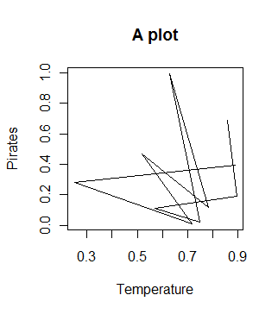
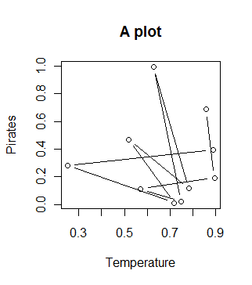
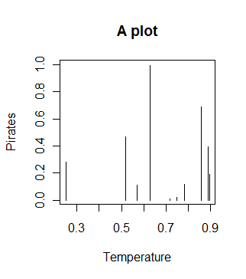
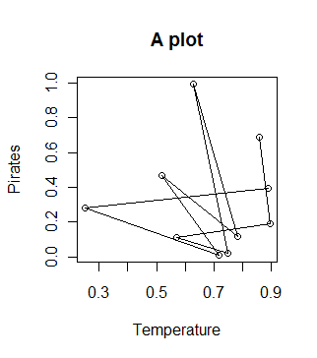
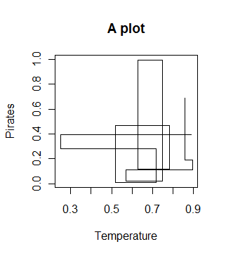
type =
“l” “b” ”h”
“o” “s”

Slide 7

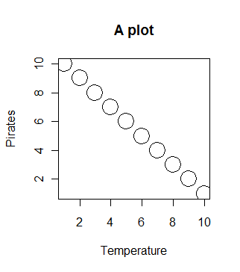
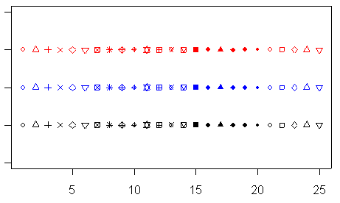
Plotting size and characters
cex = 2 or cex = 3

Slide 8
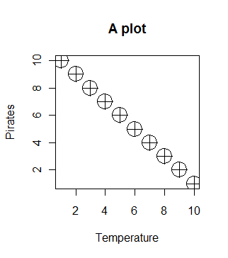
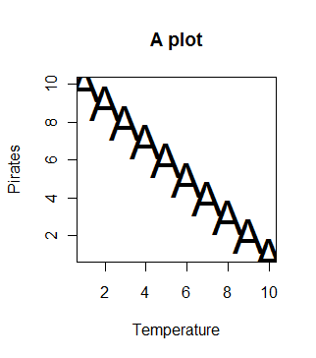
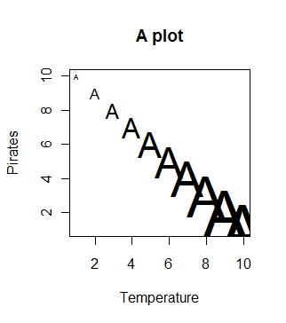
Plotting size and characters
pch = 10, cex = 3
pch = A, cex = 3
pch = A, cex = x

Slide 9
Color
By name
  “blue” or “dark grey” . . .
By function
  grey()
  rainbow()
  rgb()

Slide 10
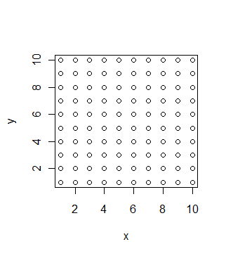
Color
x = rep(1:10,10)
y = rep(1:10,each=10)
plot(x,y)

Slide 11
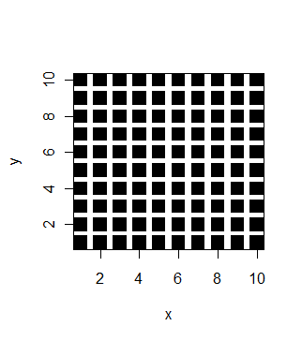
Color
x = rep(1:10,10)
y = rep(1:10,each=10)
plot(x,y,pch = 15,cex = 2)

Slide 12
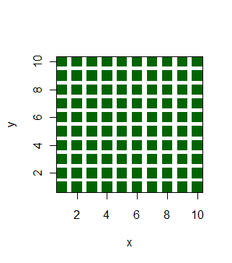
Color
x = rep(1:10,10)
y = rep(1:10,each=10)
plot(x,y,pch = 15,cex = 2,col = “dark green”)

Slide 13
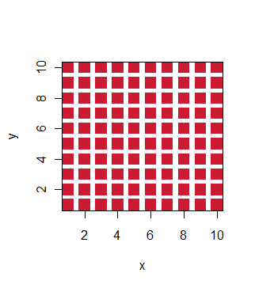
Color
x = rep(1:10,10)
y = rep(1:10,each=10)
plot(x,y,pch = 15,cex = 2,col = rgb(0.8,0.1,0.2))

Slide 14
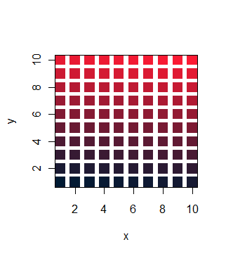
Color
x = rep(1:10,10)
y = rep(1:10,each=10)
plot(x,y,pch = 15,cex = 2,col = rgb(seq(0,1,by = 0.01),0.1,0.2))

Slide 15
Drawing on plots
points(x,y) adds points to existing plots (with very similar options to plot())
segments(x0,y0,x1,y1) draws lines from points to other points
polygons()

Slide 16
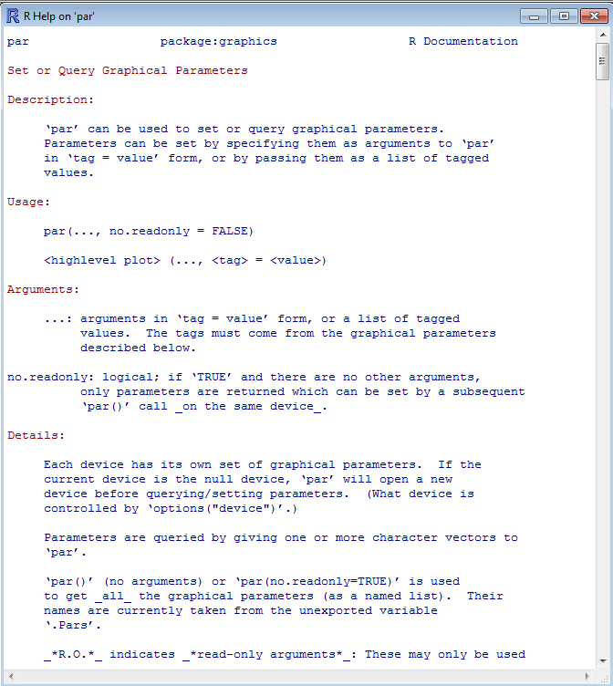
The wonderful world of par()
70 different options to control your plots!

Slide 17
Plotting to a file
pdf(), bmp()
dev.off()

Slide 18
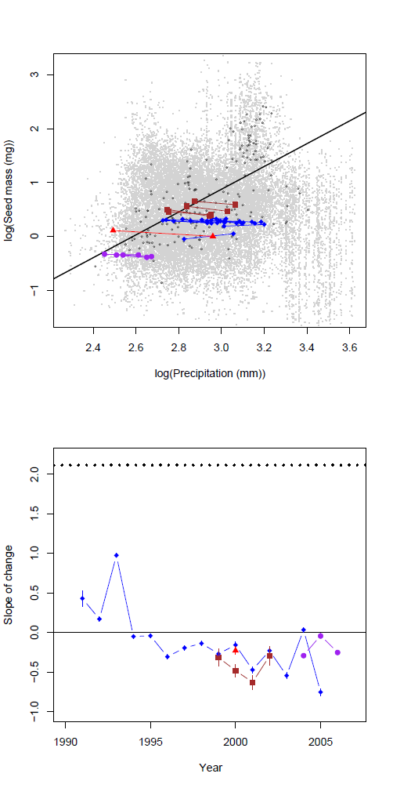
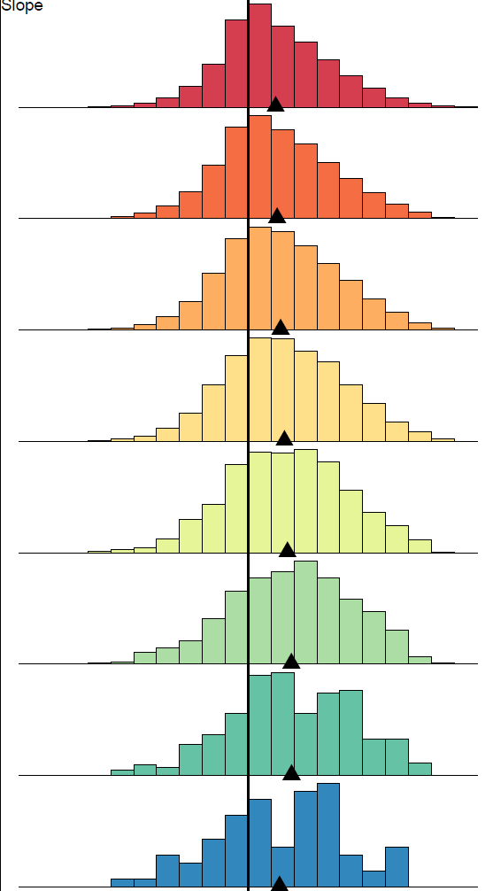
Some examples
All created entirely within R!

Slide 19
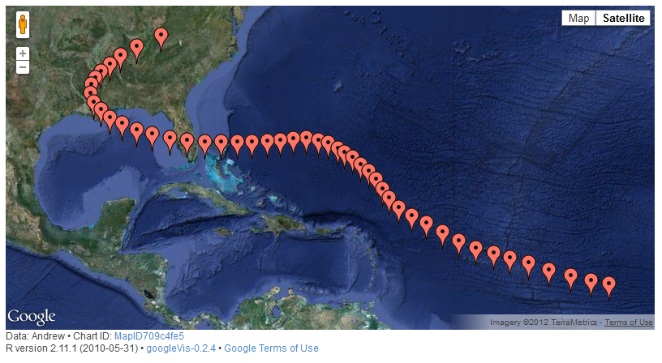
Some fun stuff
googleVis is a package that lets you use plot data on a google map (online, and therefore interactive)

Slide 20
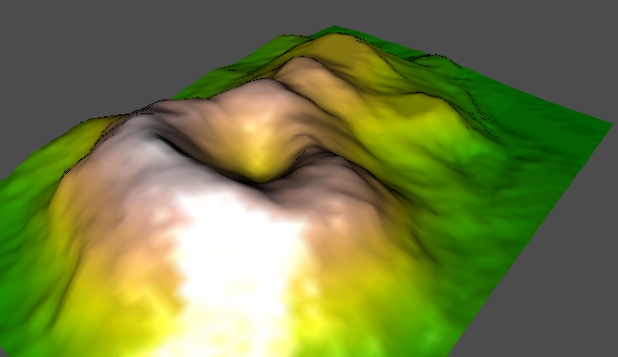
Some fun stuff
rgl lets you plot 3d surfaces and render them in real time
Demo!

Slide 21
Questions?

Slide 22
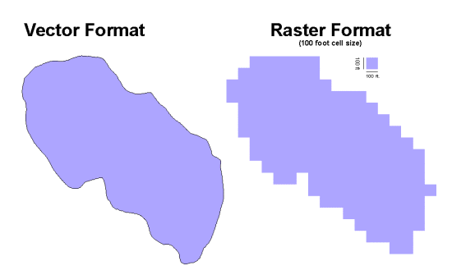
Geographic data in R
Data types
  Vector
  Raster
Packages
  maptools
  raster

Slide 23
Package maptools
readShapePoly() reads in a GIS shape file
  Can be plotted
Various functions for converting among formats
Merge polygons

Slide 24
Package raster
the raster package has everything you need for handling rasters
Read, write, plot, all kinds of queries and manipulations

Slide 25
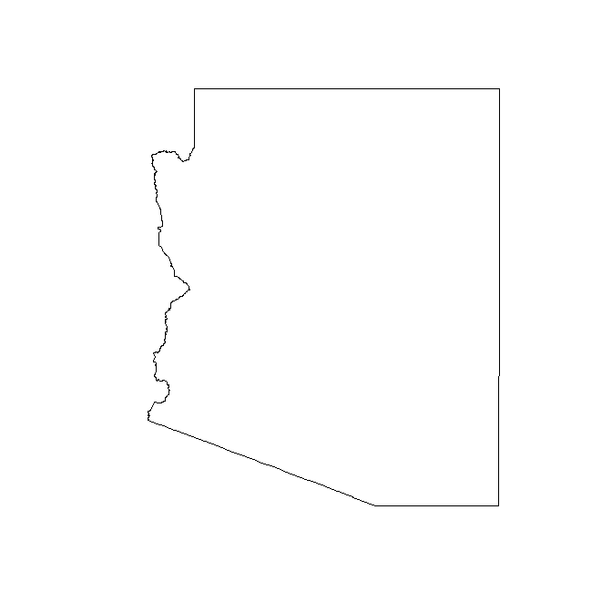
What is a shapefile?
The spatial information
Associated attributes

Slide 26
What is a shapefile?
The spatial information
Associated attributes
az@polygons[[1]]@Polygons[[1]]@coords
[,1] [,2]
[1,] -110.5393 37.00423
[2,] -110.4799 37.00393
[3,] -110.4788 37.00393
[4,] -110.4719 36.99958
[5,] -110.4610 36.99957
[6,] -110.3273 36.99947

Slide 27
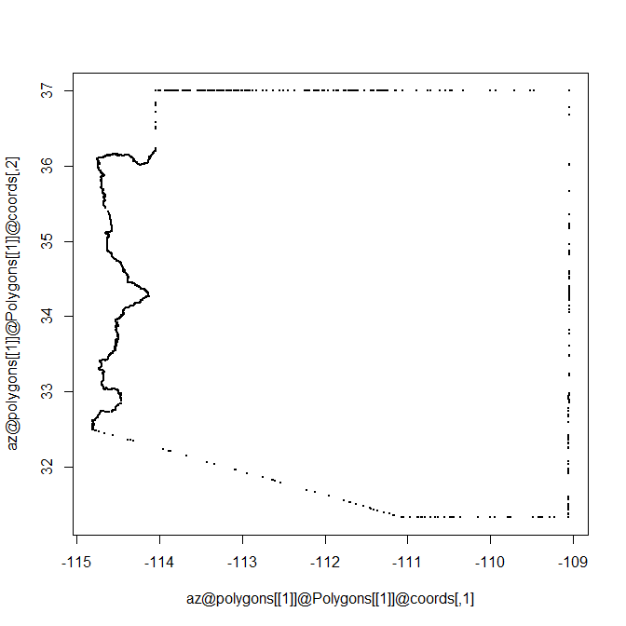
What is a shapefile?
plot(az@polygons[[1]]@Polygons[[1]]@coords)

Slide 28
What is a shapefile?
Associated attributes
  Depend on your file
  Might include names, lengths, areas etc.
  Use str(object_name) to find out what you have

Slide 29
Contents of a SpatialPolygonsDataFrame
> str(az)
Formal class 'SpatialPolygonsDataFrame' [package "sp"] with 5 slots
..@ data :'data.frame': 1 obs. of 16 variables:
.. ..$ ID_0 : int 234
.. ..$ ISO : Factor w/ 1 level "USA": 1
.. ..$ NAME_0 : Factor w/ 1 level "United States": 1
.. ..$ ID_1 : int 3193
.. ..$ NAME_1 : Factor w/ 51 levels "Alabama","Alaska",..: 3
.. ..$ VARNAME_1 : Factor w/ 51 levels "AK|Alaska","AL|Ala.",..: 4
.. ..$ NL_NAME_1 : Factor w/ 0 levels: NA
.. ..$ HASC_1 : Factor w/ 51 levels "US.AK","US.AL",..: 4
.. ..$ CC_1 : Factor w/ 0 levels: NA
.. ..$ TYPE_1 : Factor w/ 2 levels "Federal District",..: 2
.. ..$ ENGTYPE_1 : Factor w/ 2 levels "Federal District",..: 2
.. ..$ VALIDFR_1 : Factor w/ 35 levels "17710304","17760704",..: 30
.. ..$ VALIDTO_1 : Factor w/ 1 level "Present": 1
.. ..$ REMARKS_1 : Factor w/ 0 levels: NA
.. ..$ Shape_Leng: num 23.8
.. ..$ Shape_Area: num 28.9

Slide 30
..@ polygons :List of 1
.. ..$ :Formal class 'Polygons' [package "sp"] with 5 slots
.. .. .. ..@ Polygons :List of 1
.. .. .. .. ..$ :Formal class 'Polygon' [package "sp"] with 5 slots
.. .. .. .. .. .. ..@ labpt : num [1:2] -111.7 34.3
.. .. .. .. .. .. ..@ area : num 28.9
.. .. .. .. .. .. ..@ hole : logi FALSE
.. .. .. .. .. .. ..@ ringDir: int 1
.. .. .. .. .. .. ..@ coords : num [1:1655, 1:2] -111 -110 -110 -110 -110 ...
.. .. .. ..@ plotOrder: int 1
.. .. .. ..@ labpt : num [1:2] -111.7 34.3
.. .. .. ..@ ID : chr "2"
.. .. .. ..@ area : num 28.9
..@ plotOrder : int 1
..@ bbox : num [1:2, 1:2] -114.8 31.3 -109 37
.. ..- attr(*, "dimnames")=List of 2
.. .. ..$ : chr [1:2] "x" "y"
.. .. ..$ : chr [1:2] "min" "max"
..@ proj4string:Formal class 'CRS' [package "sp"] with 1 slots
.. .. ..@ projargs: chr " +proj=longlat +datum=NAD27 +ellps=clrk66 +nadgrids=@conus,@alaska,@ntv2_0.gsb,@ntv1_can.dat"
plot(az@polygons[[1]]@Polygons[[1]]@coords)

Slide 31
What is a raster?
A raster is a pixel-based (grid) format with spatial information
 |  |  | 1 | 1 | 0 | 4 | 6 | 4
 |  |  | 3 | 2 | 2 | 5 | 5 | 7
 |  |  | 4 | 5 | 4 | 8 | 5 | 3
 |  |  | 4 | 2 | 6 | 6 | 4 | 3
 |  |  | 3 | 3 | 7 | 7 | 8 | 5
 |  |  | 2 | 2 | 6 | 8 | 6 | 6
 |  |  |  | 1 | 5 | 4 | 3 | 2
 |  |  |  |  |  |  | 1

Slide 32
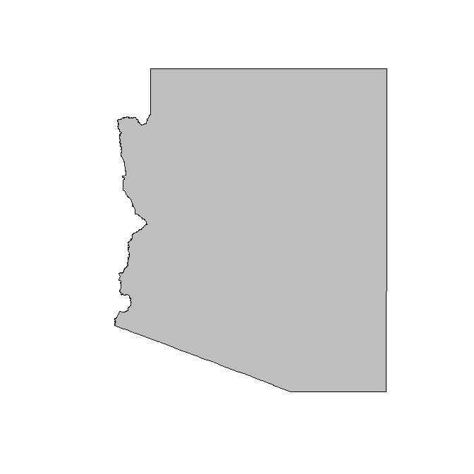
What is a raster?
A raster is a pixel-based (grid) format with spatial information
 |  |  | 1 | 1 | 0 | 4 | 6 | 4
 |  |  | 3 | 2 | 2 | 5 | 5 | 7
 |  |  | 4 | 5 | 4 | 8 | 5 | 3
 |  |  | 4 | 2 | 6 | 6 | 4 | 3
 |  |  | 3 | 3 | 7 | 7 | 8 | 5
 |  |  | 2 | 2 | 6 | 8 | 6 | 6
 |  |  |  | 1 | 5 | 4 | 3 | 2
 |  |  |  |  |  |  | 1

Slide 33
What is a raster?
A raster is a pixel-based (grid) format with spatial information
 |  |  | 1 | 1 | 0 | 4 | 6 | 4
 |  |  | 3 | 2 | 2 | 5 | 5 | 7
 |  |  | 4 | 5 | 4 | 8 | 5 | 3
 |  |  | 4 | 2 | 6 | 6 | 4 | 3
 |  |  | 3 | 3 | 7 | 7 | 8 | 5
 |  |  | 2 | 2 | 6 | 8 | 6 | 6
 |  |  |  | 1 | 5 | 4 | 3 | 2
 |  |  |  |  |  |  | 1
Extent

Slide 34
What is a raster?
A raster is a pixel-based (grid) format with spatial information
 |  |  | 1 | 1 | 0 | 4 | 6 | 4
 |  |  | 3 | 2 | 2 | 5 | 5 | 7
 |  |  | 4 | 5 | 4 | 8 | 5 | 3
 |  |  | 4 | 2 | 6 | 6 | 4 | 3
 |  |  | 3 | 3 | 7 | 7 | 8 | 5
 |  |  | 2 | 2 | 6 | 8 | 6 | 6
 |  |  |  | 1 | 5 | 4 | 3 | 2
 |  |  |  |  |  |  | 1
Resolution
Extent

Slide 35
What is a raster?
A raster is a pixel-based (grid) format with spatial information
Origin
 |  |  | 1 | 1 | 0 | 4 | 6 | 4
 |  |  | 3 | 2 | 2 | 5 | 5 | 7
 |  |  | 4 | 5 | 4 | 8 | 5 | 3
 |  |  | 4 | 2 | 6 | 6 | 4 | 3
 |  |  | 3 | 3 | 7 | 7 | 8 | 5
 |  |  | 2 | 2 | 6 | 8 | 6 | 6
 |  |  |  | 1 | 5 | 4 | 3 | 2
 |  |  |  |  |  |  | 1
Resolution
Extent

Slide 36
What is a raster?
A raster is a pixel-based (grid) format with spatial information
Origin
 |  |  | 1 | 1 | 0 | 4 | 6 | 4
 |  |  | 3 | 2 | 2 | 5 | 5 | 7
 |  |  | 4 | 5 | 4 | 8 | 5 | 3
 |  |  | 4 | 2 | 6 | 6 | 4 | 3
 |  |  | 3 | 3 | 7 | 7 | 8 | 5
 |  |  | 2 | 2 | 6 | 8 | 6 | 6
 |  |  |  | 1 | 5 | 4 | 3 | 2
 |  |  |  |  |  |  | 1
Projection, datum
Resolution
Extent

Slide 37
What is a raster object?
An R raster object contains
  A vector of values
  A size (nrow, ncol)
  Spatial information (extent, projection, datum)
A raster can have some of these things missing (for example, no data values, or no projection)

Slide 38
What is a raster object?
> mat = raster(“MAT.tif”)
> mat
class : RasterLayer
dimensions : 2882, 2880, 8300160 (nrow, ncol, ncell)
resolution : 0.004166667, 0.004166667 (x, y)
extent : 0, 12, 48, 60.00833 (xmin, xmax, ymin, ymax)
projection : +proj=longlat +ellps=WGS84 +datum=WGS84 +no_defs +towgs84=0,0,0
values : C:/Users/brody/Documents/Teaching/R for Macroecology/Week 4/MAT.tif
min : ?
max : ?
Where’s the data?

Slide 39
Raster objects are different!
Normal objects are stored in memory, for fast access
Raster objects are not always
  When you define a raster object R looks at the summary information and remembers the hard drive locations
  Small rasters often do reside in memory
Advantages and disadvantages

Slide 40
The structure of a raster object
Stored as a big vector
1
2
3
4
5
6
7
8
9
.
.
.
.
n
ncol = 8
1 2 3 4 5 6 7 8
9 . . . .
. . . .
. . . .
. . . .
. . . .
. . . . . . . . . . . n

Slide 41
Create a new raster
> newRaster = raster(nrows = 10,ncols = 6,xmn = 0,xmx = 6,ymn = 50,ymx = 60,crs = "+proj=longlat +datum=WGS84")
> newRaster
class : RasterLayer
dimensions : 10, 6, 60 (nrow, ncol, ncell)
resolution : 1, 1 (x, y)
extent : 0, 6, 50, 60 (xmin, xmax, ymin, ymax)
projection : +proj=longlat +datum=WGS84 +ellps=WGS84 +towgs84=0,0,0
values : none

Slide 42
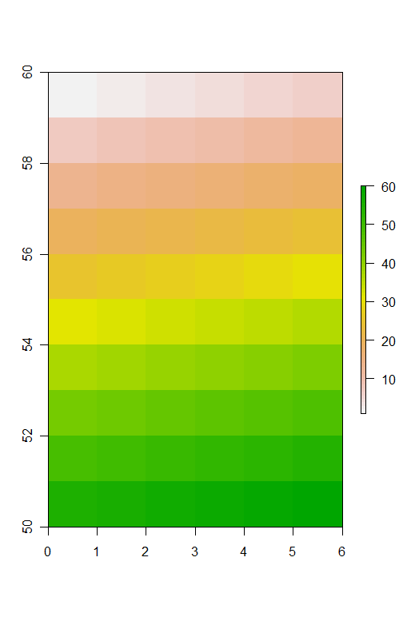
Create a new raster
> newRaster = setValues(newRaster,1:60)
> plot(newRaster)

Slide 43
Getting values from a raster
> newRaster[22]
[1] 22
> newRaster[2,4]
[1] 10
> getValues(newRaster)[12]
[1] 12

Slide 44
Plotting a raster
plot()
  xlim and ylim control plotting window (just like usual)
  col specifies the color palette (this works a bit differently)
  subsample (defaults to TRUE) determines whether or not to plot every pixel (if TRUE, only plots at most maxpixel pixels)
colors
  rbg(), rainbow(), heat.colors(), terrain.colors(), topo.colors()
  I also like the colors in fBasics package
Can also use image()
  Similar, but no scale bar

Slide 45
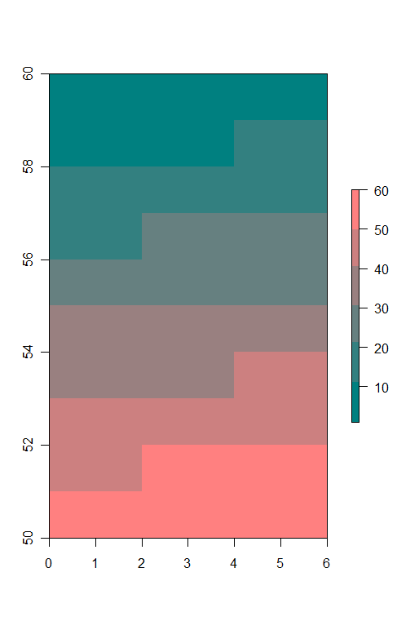
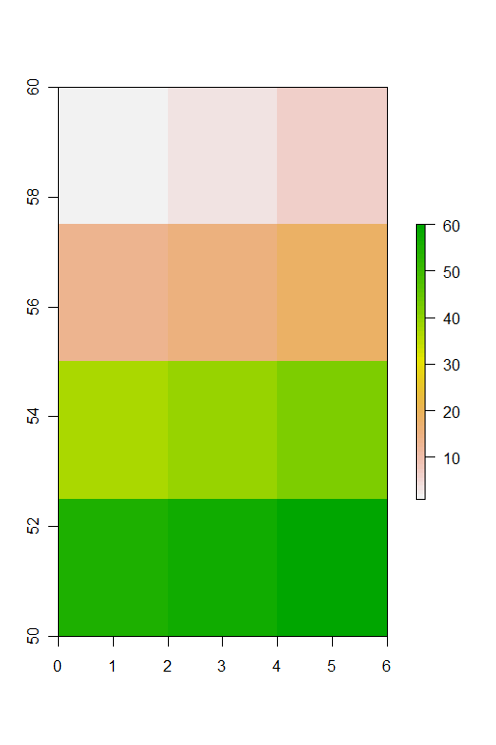
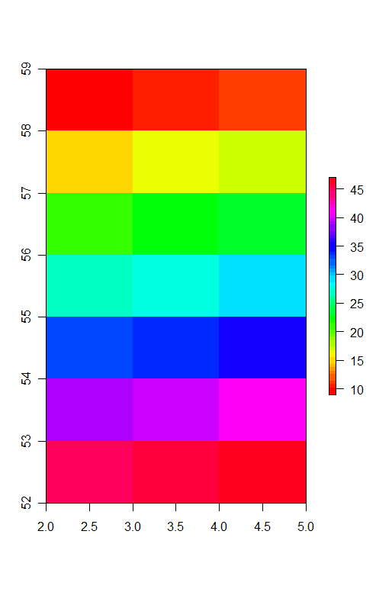
Plotting examples
plot(newRaster,col = rgb(seq(0,1,0.2),0.5,0.5))
plot(newRaster,maxpixels = 7)
plot(newRaster,xlim = c(2,5),ylim = c(52,59),col = rainbow(50))

Slide 46
A few useful ways to explore rasters
zoom()
  Opens a new active plotting window with the selected region
click()
  Queries a value, if xy = TRUE, also returns the x and y coordinates

Slide 47
Polygon -> Raster
rasterize(polygon, raster)

Slide 48
Polygon -> Raster
rasterize(polygon, raster)

Slide 49
Polygon -> Raster
rasterize(polygon, raster)
0 | 0 | 0 | 1 | 1 | 1 | 1 | 1 | 0 | 0
0 | 0 | 1 | 1 | 1 | 1 | 1 | 1 | 0 | 0
0 | 0 | 0 | 1 | 1 | 1 | 1 | 1 | 0 | 0
0 | 0 | 0 | 1 | 1 | 1 | 1 | 1 | 0 | 0
0 | 0 | 0 | 1 | 1 | 1 | 1 | 1 | 0 | 0
0 | 0 | 0 | 1 | 1 | 1 | 1 | 1 | 0 | 0
0 | 0 | 0 | 0 | 1 | 1 | 1 | 1 | 0 | 0
0 | 0 | 0 | 0 | 0 | 0 | 0 | 0 | 0 | 0

Slide 50
What is a projection?
A representation of the spherical world on the plane
They always produce some distortion (of shape, area or direction)
Projection, datum, ellipse
  Projection describes how the spherical coordinates are flattened
  Datum describes how the Earth ellipsoid is modeled
projInfo(“proj”) and projInfo(“datum”) show you the options available
More info here:
  http://www.remotesensing.org/geotiff/proj_list/

Slide 51
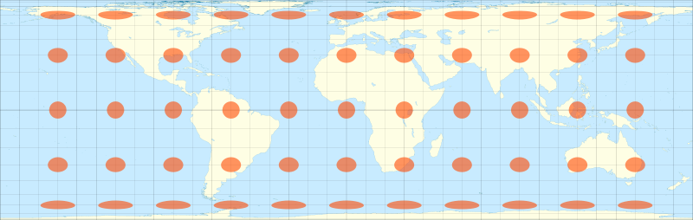
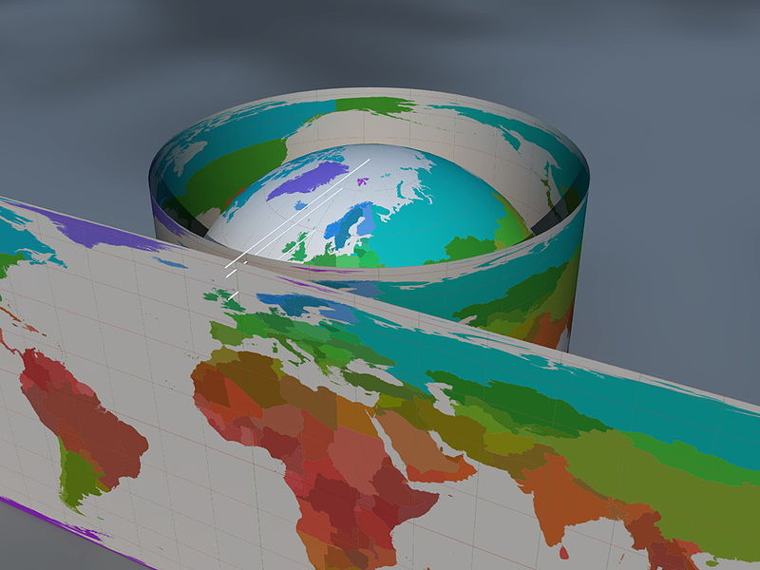
Projections
Cylindrical projections
Lambert CEA

Slide 52
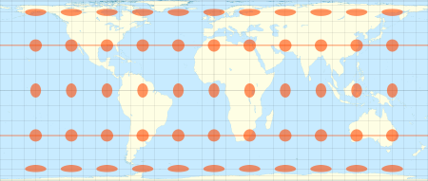
Behrmann EA
Latitude of true scale = 30

Slide 53
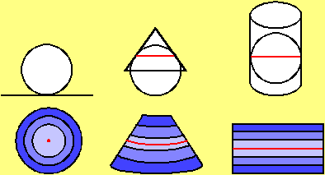
Choosing a projection
What properties are important?
  Angles (conformal)
  Area (equal area)
  Distance from a point (equidistant)
  Directions should be strait lines (gnomonic)
Minimize distortion
  Cylindrical, conic, azimuthal
http://www.geo.hunter.cuny.edu/~jochen/gtech201/lectures/lec6concepts/map%20coordinate%20systems/how%20to%20choose%20a%20projection.htm

Slide 54
Projections in R
Projections in R use the proj.4 library
This is a system of codes to describe the projection
“+proj=longlat +datum=WGS84”
“+proj=cea +datum=NAD83 +lat_ts=30 +lon_0=45”

Slide 55
Projecting points
project() function in the rgdal package is good
spTransform() (in rgdal) works for SpatialPoints, SpatialLines, SpatialPolygons . . .
  Can also handle transformations from one datum to another

Slide 56
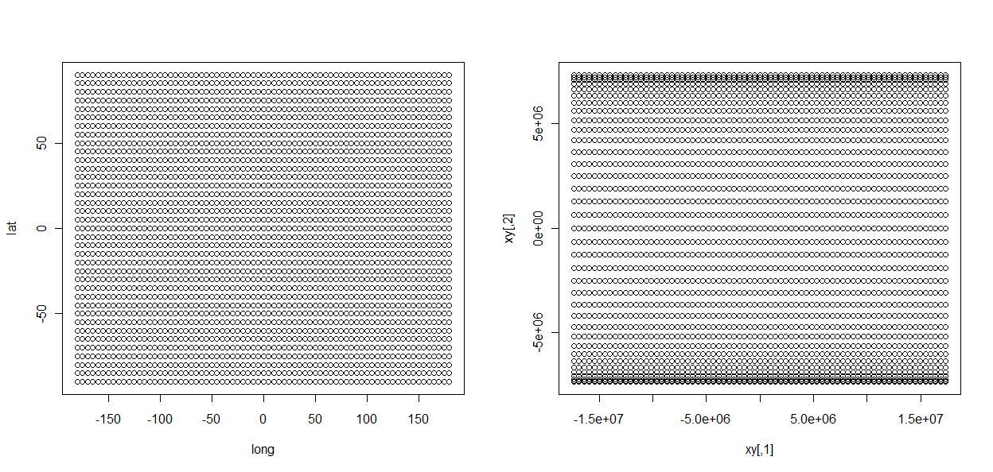
Projecting points
> lat = rep(seq(-90,90,by = 5),(72+1))
> long = rep(seq(-180,180,by = 5),each = (36+1))
> xy = project(cbind(long,lat),"+proj=cea +datum=WGS84 +lat_ts=30")
> par(mfrow = c(1,2))
> plot(long,lat)
> plot(xy)

Slide 57
Projecting points
> lat = rep(seq(-90,90,by = 5),(72+1))
> long = rep(seq(-180,180,by = 5),each = (36+1))
> xy = project(cbind(long,lat),"+proj=cea +datum=WGS84 +lat_ts=30")
> par(mfrow = c(1,2))
> plot(long,lat)
> plot(xy)
project() assumes that the starting coordinates are in lat/long, and that you want to project into another coordinate system. If instead, your points are in another system and you want to go to lat/long, that is called an inverse projection, and you use inv=T

Slide 58
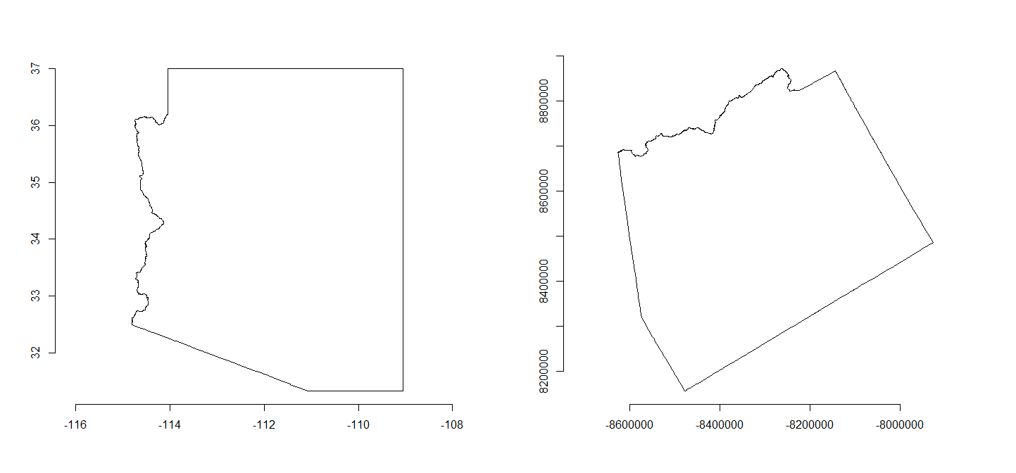
Projecting a shape
spTransform() in the rgdal package
az2 = spTransform(az,CRS("+proj=aea +lat_1=22 +lat_2=45"))
plot(az2)

Slide 59
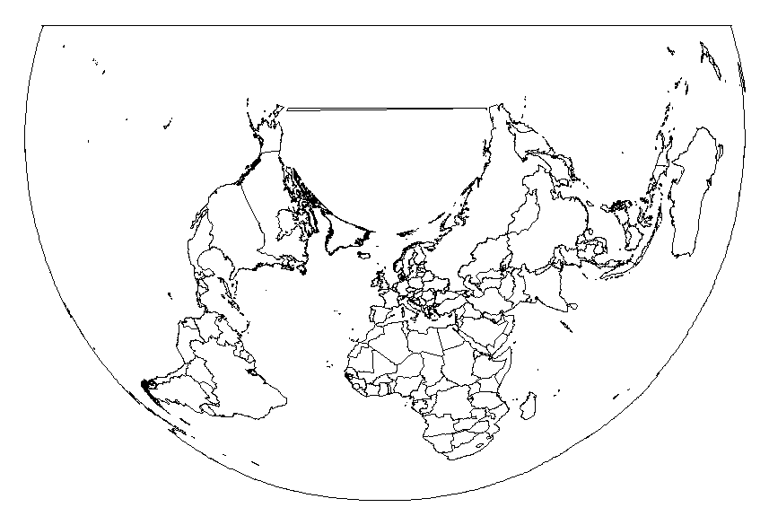
Some examples
plot(spTransform(wm,CRS("+proj=aea +lat1=-20 +lat2=20")))

Slide 60
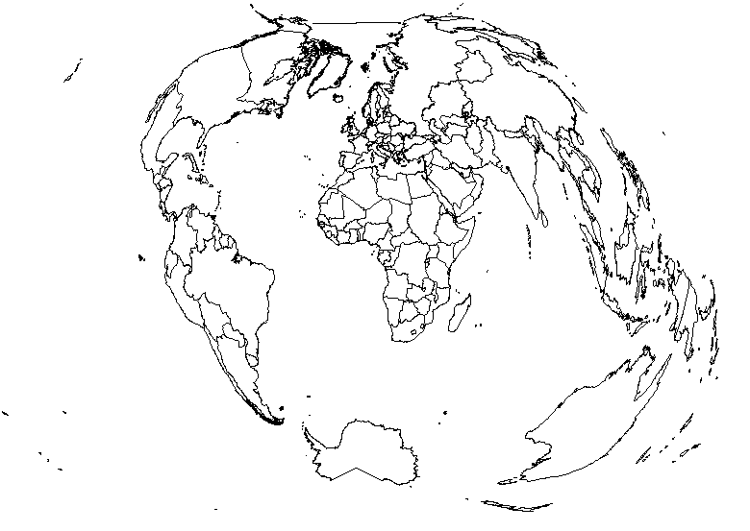
Some examples
plot(spTransform(wm,CRS("+proj=rpoly")))

Slide 61
Projecting a grid
Projecting a grid is conceptually harder
The approach is basically:
  Create a new grid in the new coordinate system
  Fill that grid with values by interpolating (or just sampling) from the old grid

Slide 62
Projecting a grid
> mat = raster("MAT.tif")
> mat = aggregate(mat,10)
> bea = projectExtent(mat,"+proj=cea +datum=WGS84 +lat_ts=30")
> mat
class : RasterLayer
dimensions : 289, 288, 83232 (nrow, ncol, ncell)
resolution : 0.04166667, 0.04166667 (x, y)
extent : 0, 12, 47.96667, 60.00833 (xmin, xmax, ymin, ymax)
projection : +proj=longlat +ellps=WGS84 +datum=WGS84 +no_defs +towgs84=0,0,0
values : in memory
min value : -22.88
max value : 113.56
> bea
class : RasterLayer
dimensions : 289, 288, 83232 (nrow, ncol, ncell)
resolution : 4016.896, 3137.077 (x, y)
extent : 0, 1156866, 5450663, 6357279 (xmin, xmax, ymin, ymax)
projection : +proj=cea +datum=WGS84 +lat_ts=30 +ellps=WGS84 +towgs84=0,0,0
values : none

Slide 63
Projecting a grid
> bea = projectExtent(mat,"+proj=cea +datum=WGS84 +lat_ts=30")
> res(bea) = xres(bea)
> matBEA = projectRaster(mat,bea)
> mat
class : RasterLayer
dimensions : 289, 288, 83232 (nrow, ncol, ncell)
resolution : 0.04166667, 0.04166667 (x, y)
extent : 0, 12, 47.96667, 60.00833 (xmin, xmax, ymin, ymax)
projection : +proj=longlat +ellps=WGS84 +datum=WGS84 +no_defs +towgs84=0,0,0
values : in memory
min value : -22.88
max value : 113.56
> matBEA
class : RasterLayer
dimensions : 169, 288, 48672 (nrow, ncol, ncell)
resolution : 4638.312, 4638.312 (x, y)
extent : 0, 1335834, 4721690, 5505565 (xmin, xmax, ymin, ymax)
projection : +proj=cea +datum=WGS84 +ellps=WGS84 +towgs84=0,0,0 +lat_ts=30
values : in memory
min value : -21.65266
max value : 113.3013

Slide 64
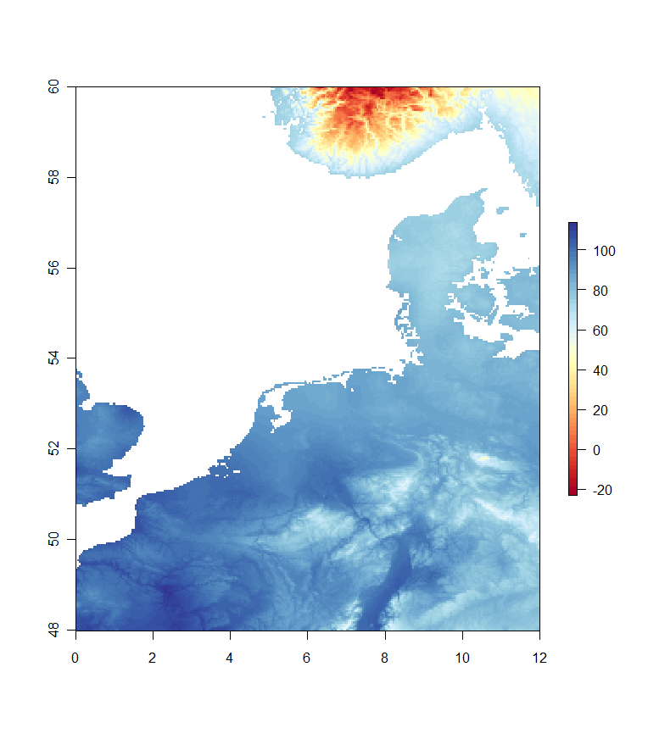
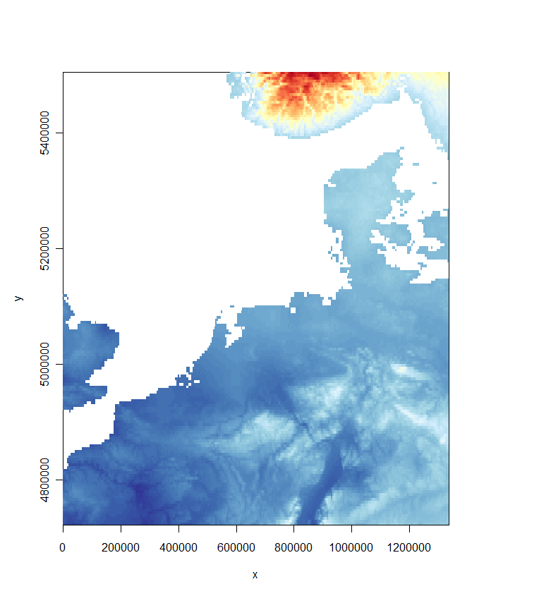
How does it look?

Slide 65
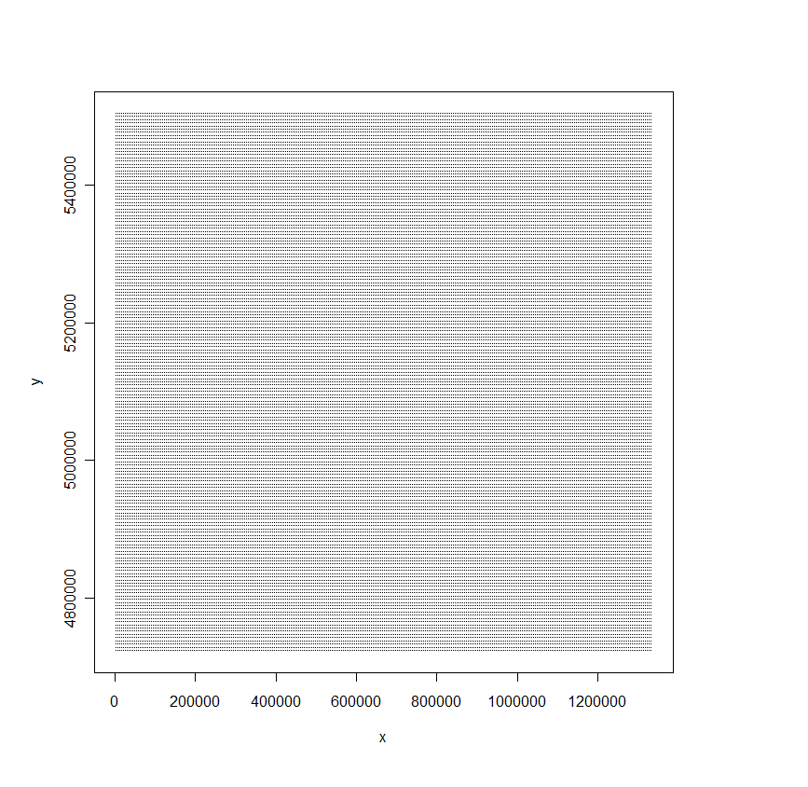
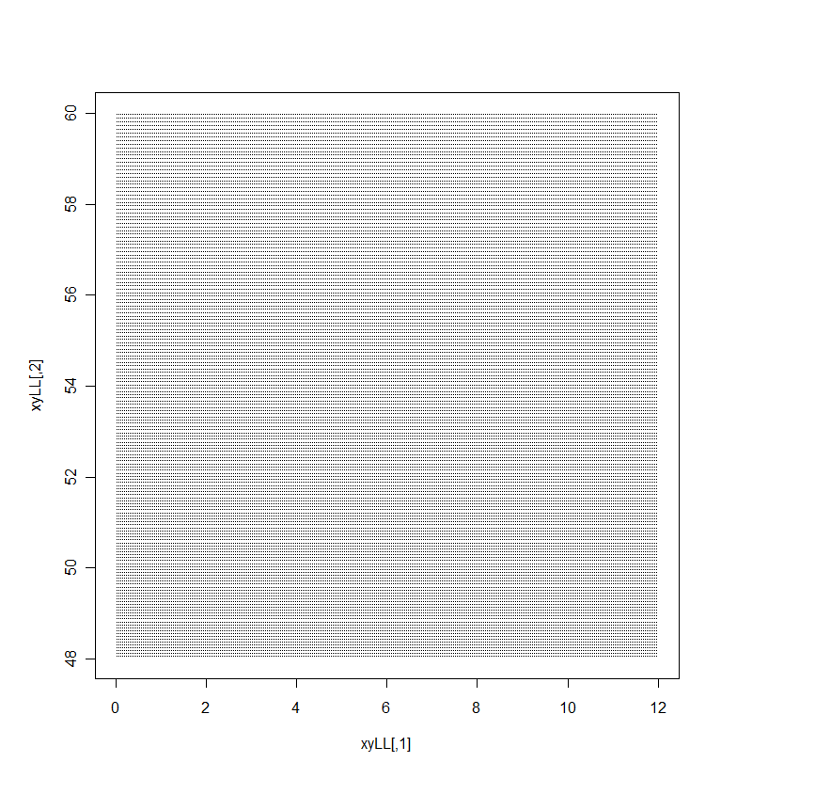
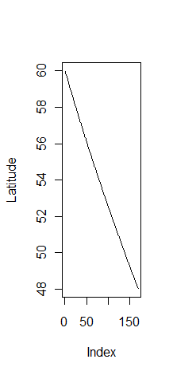
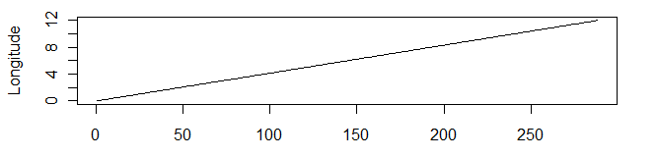
What happened?
x = xFromCell(bea,1:ncell(bea))
y = yFromCell(bea,1:ncell(bea))
plot(x,y,pch = ".")
xyLL = project(cbind(x,y), "+proj=cea +datum=WGS84 +latts=30”,inverse = T)
plot(xyLL,pch = ".")

Slide 66

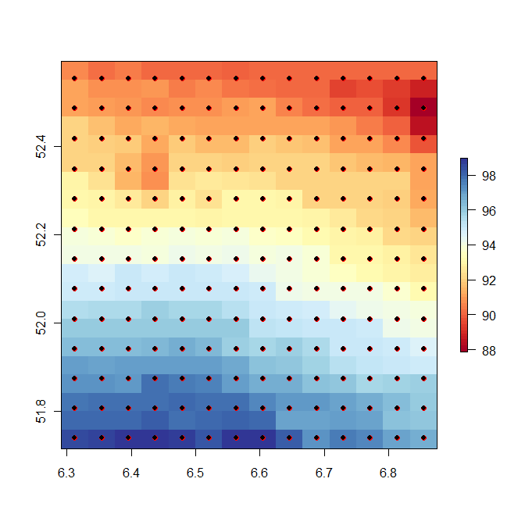
What happened
Grid of points in lat-long (where each point corresponds with a BEA grid cell)
Sample original raster at those points (with interpolation)
Different spacing in
y direction
Identical spacing in x direction

Slide 67
What are the units?
> matBEA
class : RasterLayer
dimensions : 169, 288, 48672 (nrow, ncol, ncell)
resolution : 4638.312, 4638.312 (x, y)
extent : 0, 1335834, 4721690, 5505565 (xmin, xmax, ymin, ymax)
projection : +proj=cea +datum=WGS84 +ellps=WGS84 +towgs84=0,0,0 +lat_ts=30
values : in memory
min value : -21.65266
max value : 113.3013
Meters, along the latitude of true scale (30N and 30S)

Slide 68
That’s it!
Try it out

