Slide 1
Dispersal and ecological patterns
CIRCE
Ecoinformatics approaches to understand ecological processes in a changing world

Slide 2
Overview of lecture
Background – some thoughts on complexity
Sources of complexity
Scales of complexity
Metacommunity ecology
Dispersal
Methods for analysing the relative role of env and dispersal in community assembly

Slide 3
What is arguably the largest problem/challenge/interesting thing in community ecology – maybe ecology?

Slide 4
COMPLEXITY

Slide 5
Sources of complexity in ecosystems
Environmental variation
Dispersal
Biotic interactions
SCALE
Notes:
Sources are operating at a number of scales – vital to keep in mind the scales at which the patterns and processes are relevant and which scales they are operating at

Slide 6
Scales of interest today
Local – varies genarally unit of measurement
Regional (~ 10¹-10⁵ km²)
Notes:
We always measure biological assemblage and species locally but many of the processes and some patterns are operate or are observable regionally
How are the local and the regional linked?

Slide 7
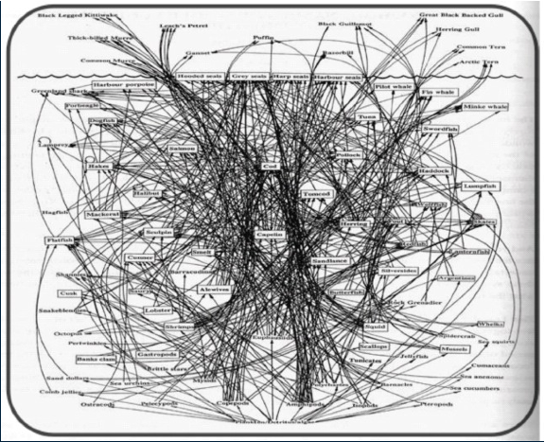
Local complexity
Notes:
Complexity of a marine food web

Slide 8
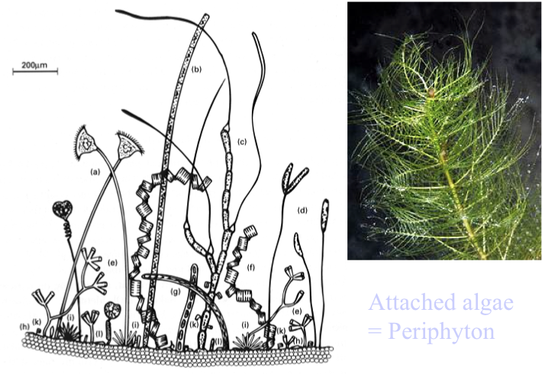
micro-scale complexity
Notes:
Do the different scales have different drivers and operate at different time scales – stationarity? Big assumption of many stats techniques.
What are the causes and consequences of this complexity – does it need so many taxa? How are they important to ecosystem function?

Slide 9
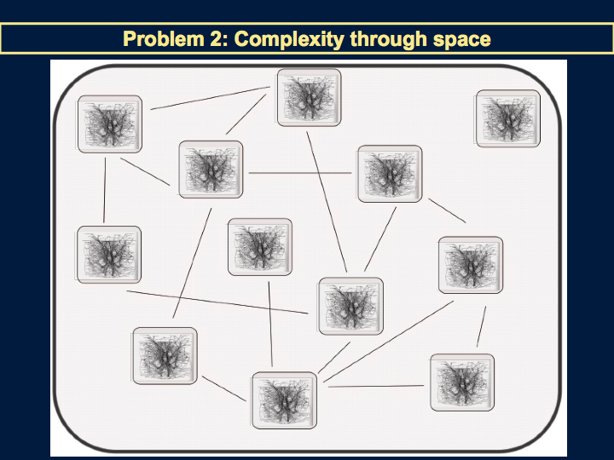
Notes:
Regional scale complexity. What connects communities in space? What do the lines here represent?

Slide 10
Regional scale
Environmental variation
Dispersal
Biotic interactions
Notes:
Some background to causes of regional variation

Slide 11
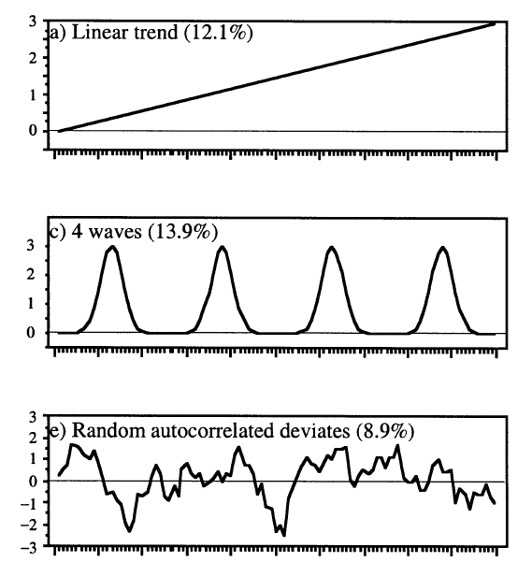
Types of variation
Gradients / Trends
Patchy / Clumped patterns
Linear geographic location
Source: Borcard et al. (2002) Ecol.Model. 153:51+
Notes:
Links to methods for this afternoon.. Variation can take many different patterns

Slide 12
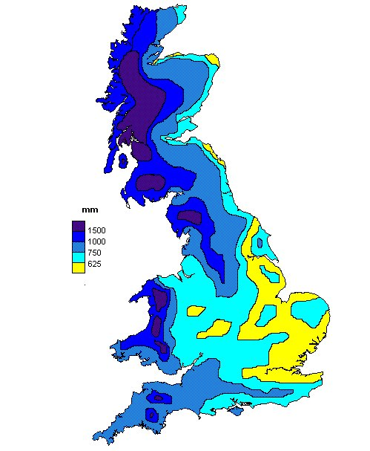
Climate
Source: http://www.ace.mmu.ac.uk/Resources/Teaching_Packs/Key_Stage_4/Weather_Climate/11.html

Slide 13
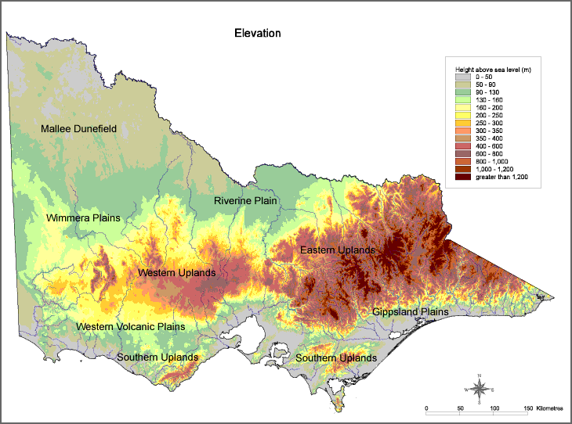
Elevation & topography: regional scales
Victoria, AUS
Sourcs: www

Slide 14
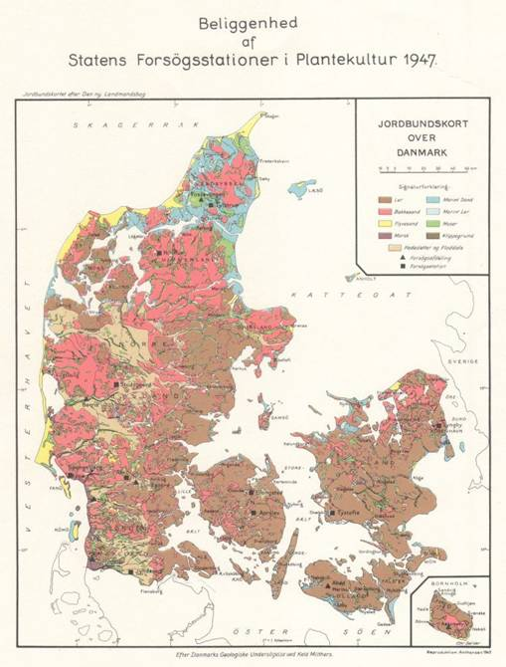
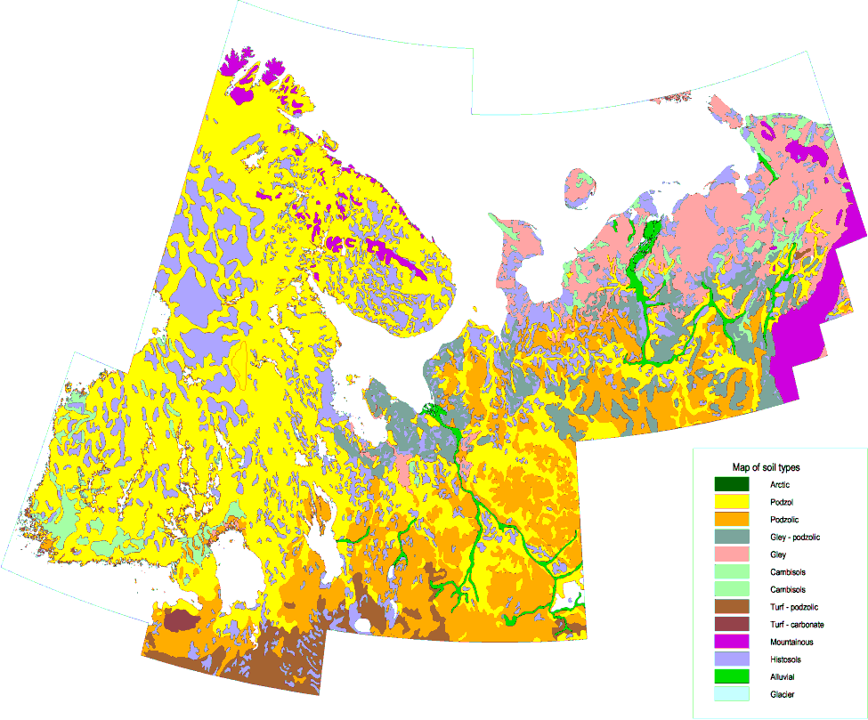
Soils
Soil types in Finland s.l.
Sources: www

Slide 15
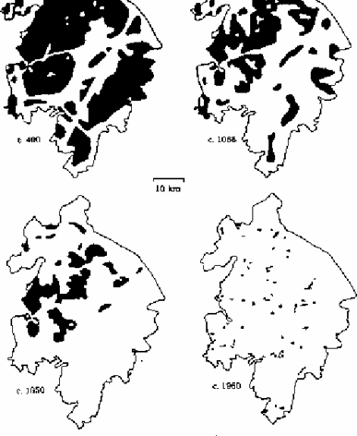
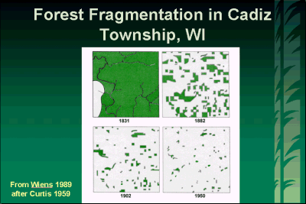
Anthropogenic habitat loss
Source: www

Slide 16
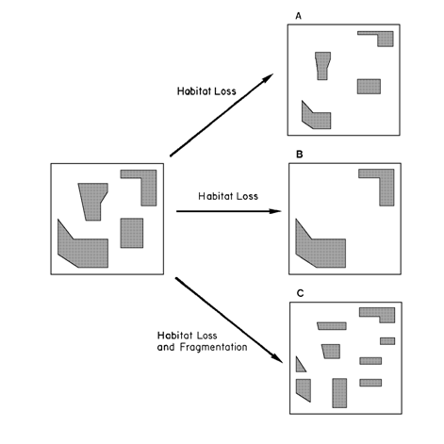
Human habitat loss
Two effects
  Area loss
  Fragmentation
Source: www

Slide 17
Types of variation
Gradients / Trends
Patchy / Clumped patterns
Linear geographic location
Source: Borcard et al. (2002) Ecol.Model. 153:51+
Notes:
So in representations of space used in analysis it is important to represent all these different types of variation.
This links to the PCNM analysis we will do later
…

Slide 18
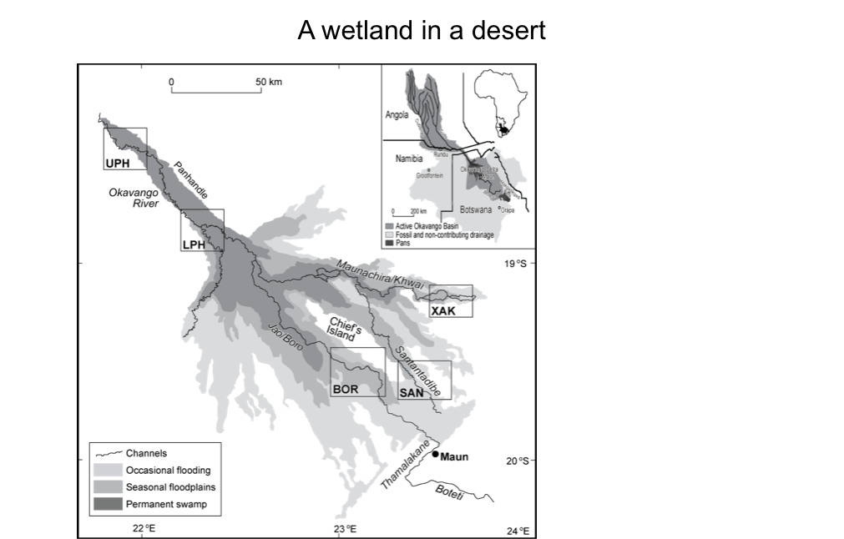
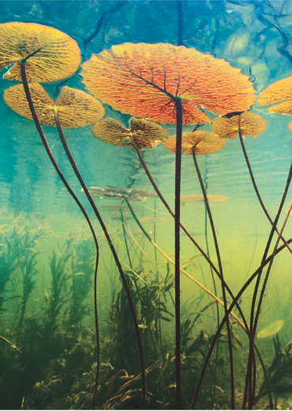
Variation in space and time

Slide 19
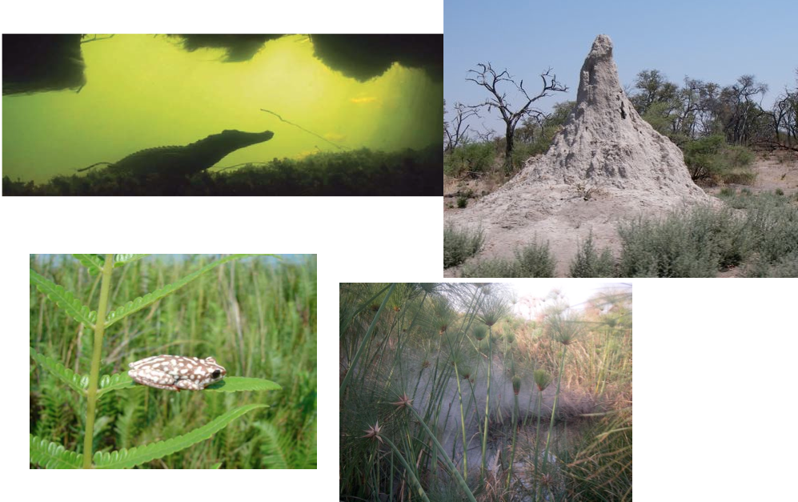

Slide 20
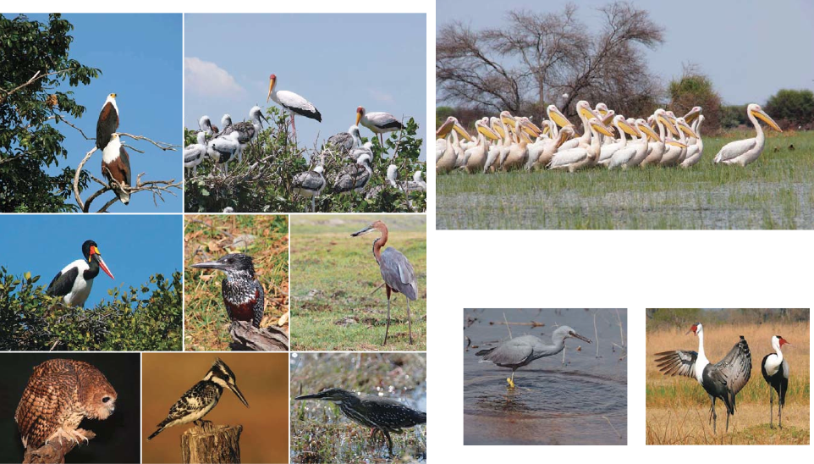

Slide 21
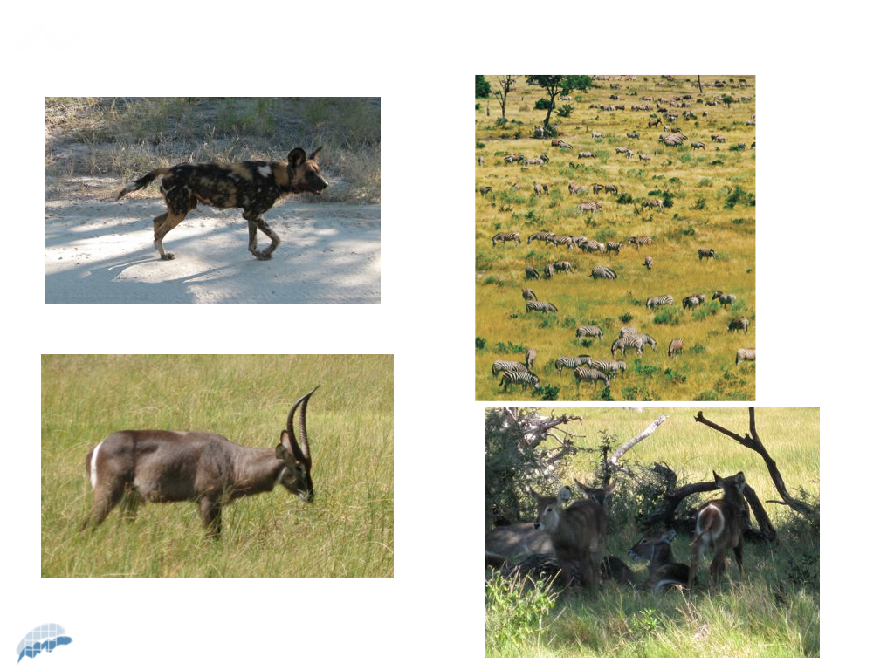

Slide 22
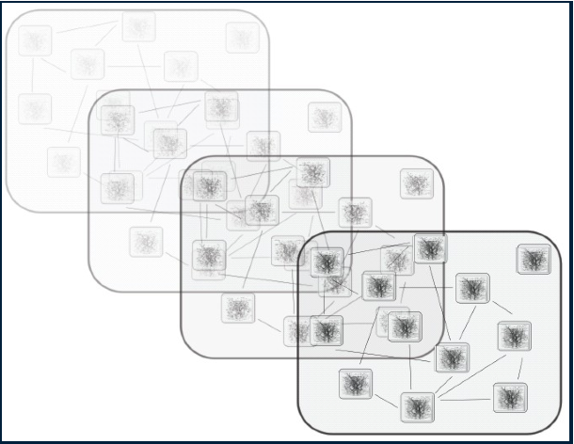
Complexity through time
Notes:
Complexity or variation in environmental gradients over time

Slide 23
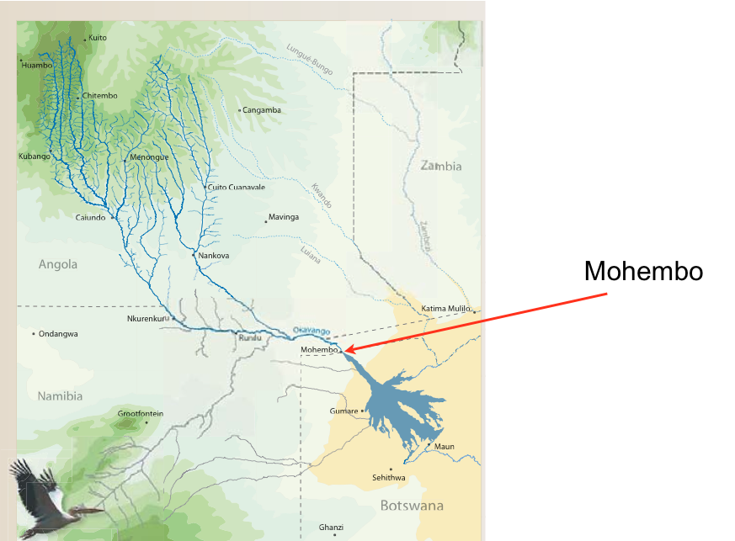

Slide 24
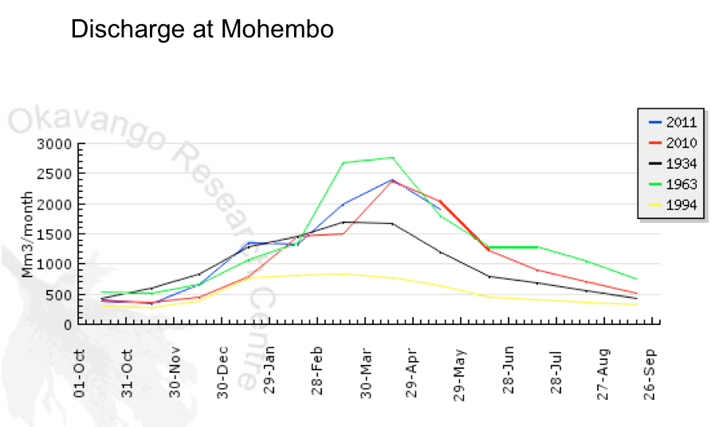

Slide 25
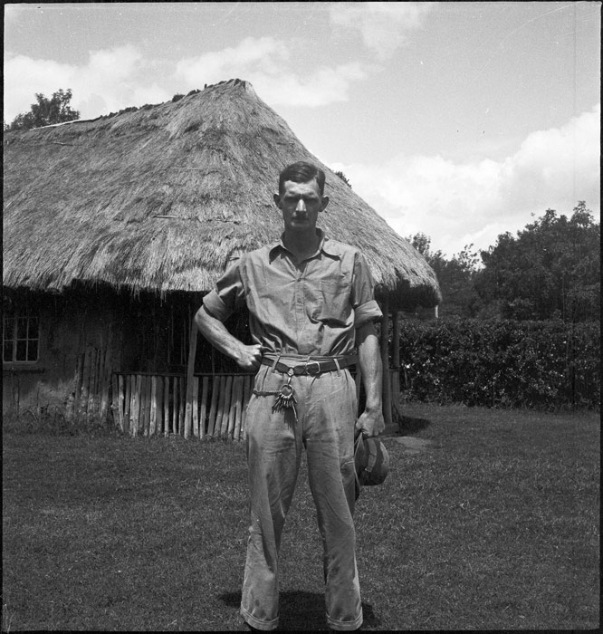
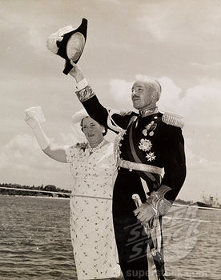
Three cheers for the British!

Slide 26
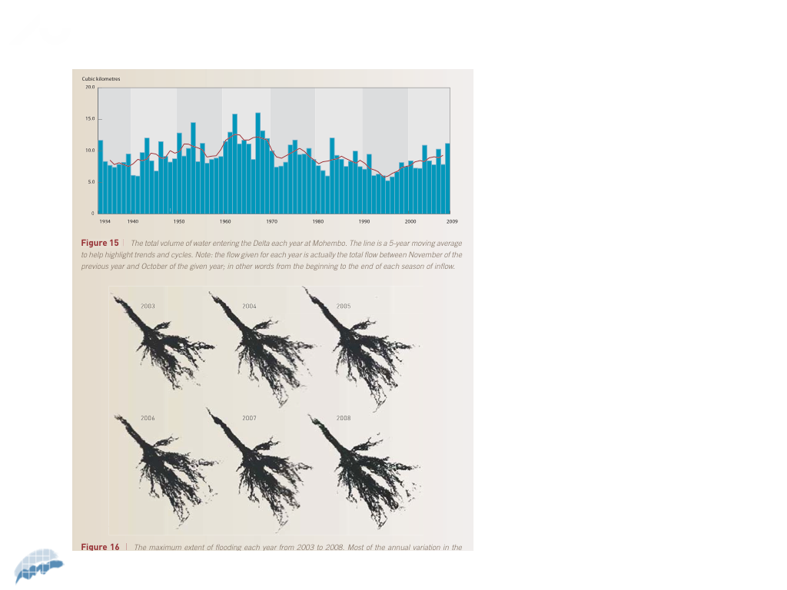
Past variation effects the present community
Notes:
Complexity of drivers can be a bit frightening when you think of analysis – in the absence of the historical information it would be very very difficult to explain the current community structure.
The importance of the antecedent 16 years at least can be seen in the current communities

Slide 27
Implications for regional structure and dynamics of populations and communities
Environmental gradients/trends
↓
Spatial heterogeneity in structure/dynamics
Environmental patchiness
↓
”Island biogeographic” effects
  Dispersal + Extinction / Area + Isolation effects
Notes:
So we talked about env gradients as a background – suitable habitats are often in discrete areas with different degrees of isolation and therefore dispersal may be an important factor shaping the community.
Patchiness in suitable habitats – we are all v familiar with in space

Slide 28
Notes:
So far we have discussed environmental heterogeneity and how that leads to complexity and variation in space there may well be other factors at work.

Slide 29
What links the different communities?
Dispersal

Slide 30
Freshwater dispersal mechanisms
Transport of diaspores via water
Thought to be most important mechanism for plant dispersal - especially in riverine environments
Key controls over hydrochary
  buoyancy - varies enormously between species - but most seeds sink quickly
  currents
  fragmented nature of aquatic landscape - see
  Andersson (2000)

Slide 31
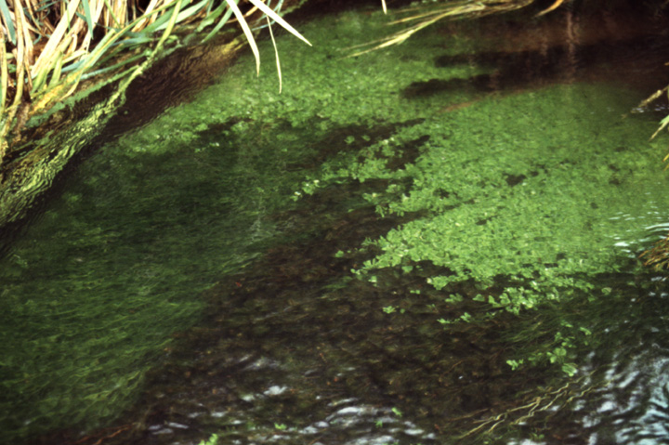

Slide 32

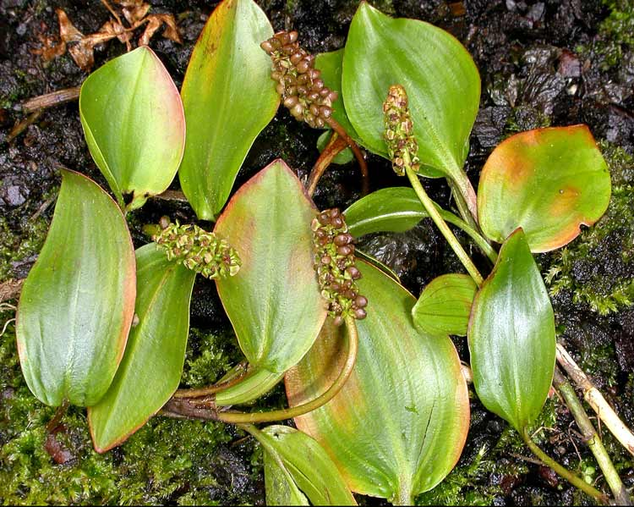
Nuphar lutea - brandy bottle
- With few exceptions seeds of water plants sink quickly
- But temporary buoyancy has been observed
- Key importance of rafting plant debris after plant die-back - seeds
may still be attached to inflorescence or indeed whole plants

Slide 33
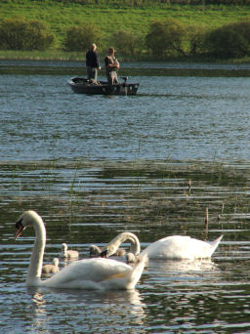
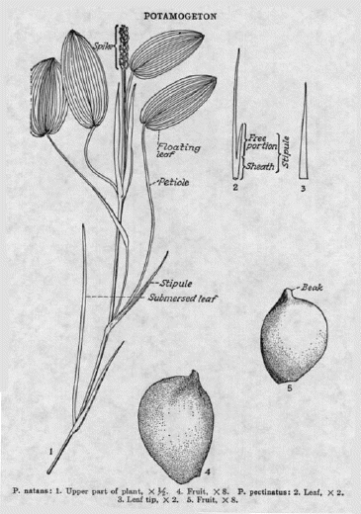
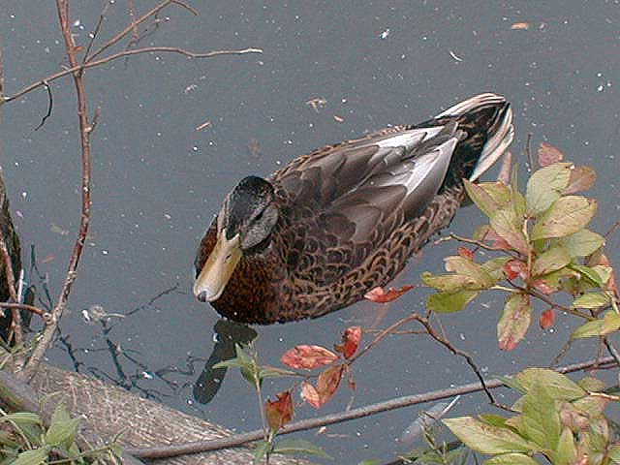
Endozoochory
Active animal dispersal
Notes:
Also Epizoochory – classic study of ducks feet – back to Darwin

Slide 34
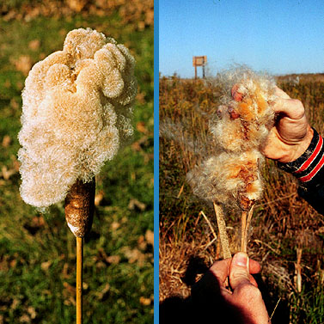
Wind dispersal
Typha
wind-dispersed
leads to long-range
dispersal

Slide 35
(Freshwater) dispersal: What do we know?
Rates ??
Extent??
Variable in space/time and between and within groups
Direct measurements very difficult – meaningful?
Indirect methods have generally been prefered

Slide 36
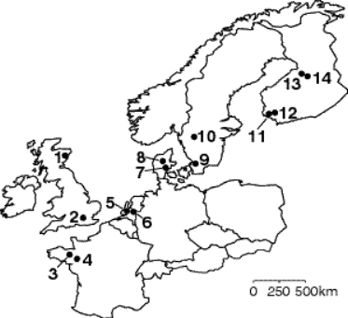
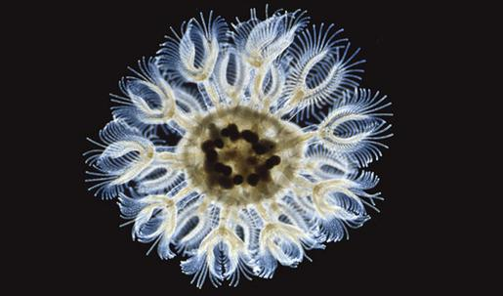
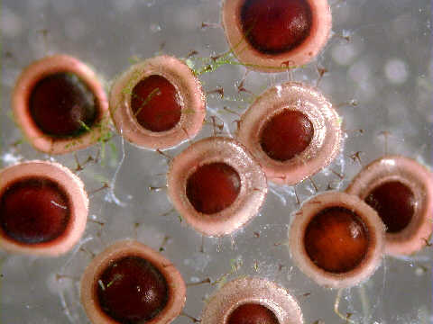
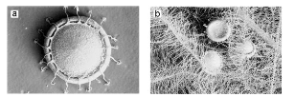
Genetic consequences of the metapopulation biology of a facultatively sexual freshwater invertebrate
Freeland et al . 2001 Journal of Evolutionary Biology
Volume 13, Issue 3, pages 383-395
Notes:
Our data illustrate a metapopulation comprising well-differentiated populations connected by low levels of ongoing gene flow, patterns that agree with predictions based on theoretical work. However, contrary to expectations of a metapopulation, particularly one in which asexual reproduction predominates, genetic variation within populations was often high. This diversity seems to be at least partially attributable to the gene flow that results from ongoing dispersal.

Slide 37
^{Dispersal: What do we know?}
(freshwater again)
No dispersal limitation (De Meester et al. 2002) => dispersal potential?
Dispersal limiting (Bohonak and Jenkins 2003) => actual dispersal?
Think of the organisms/ecosystems you work with. Is there any good data on dispersal rates? Limitation? Actual dispersion?

Slide 38
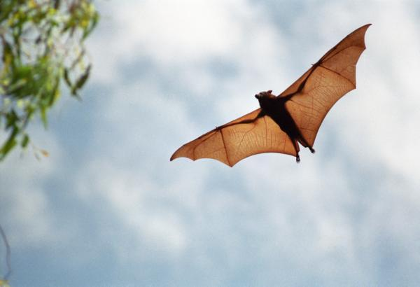
Terrestrial examples – bats in neotropical forests
KELM, D. H., WIESNER, K. R. and HELVERSEN, O. v. (2008), Effects of Artificial Roosts for Frugivorous Bats on Seed Dispersal in a Neotropical Forest Pasture Mosaic. Conservation Biology, 22: 733–741.

Slide 39
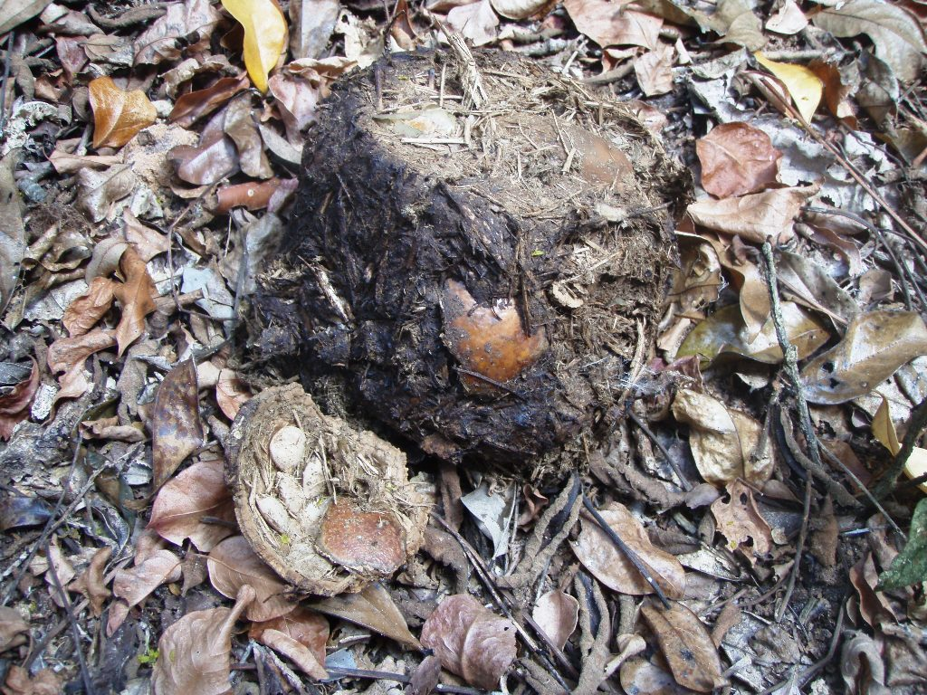
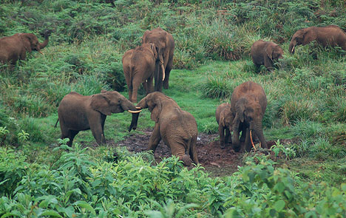
Who did this?

Slide 40
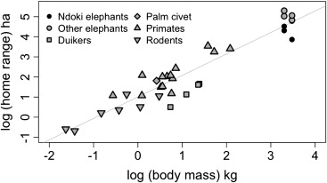
Mega-gardeners of the forest – the role of elephants in seed dispersal
Fig. 2 Body size to home range relationships for selected mammalian forest seed dispersers in the Congo Basin
Campos-Arceiz & Blake. Acta Oecologica Volume 37, Issue 6 2011 542 - 553

Slide 41
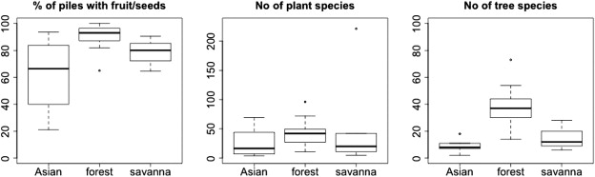
Mega gardeners of the forest – the role of elephants in seed dispersal
Fig. 3 Presence of seeds, number of species, and number of tree species in the dung of Asian, African forest, and African savannah elephants.
Campos-Arceiz & Blake. Acta Oecologica Volume 37, Issue 6 2011 542 - 553
Notes:
What would be really interesting extension for this study? Examination of the effects of this greater seed dispersal in the presence of dispersers? But what sort of temporal dynamics are at work with such long lived taxa as elephants and trees.
Can see the effects in forest assemblages and in stucture of forest community.

Slide 42
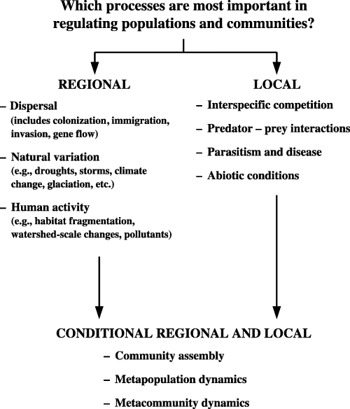
Ecological and evolutionary significance of dispersal (by freshwater invertebrates)
Bohonak and Jenkins 2003 Ecology Letters Volume 6, Issue 8, pages 783-796.
Notes:
Conceptual framework for studies of community assembly and regulation. Processes can be divided into those that are strictly regional, those that are strictly local, and those which involve conditional combinations of regional and local factors

Slide 43
Metapopulations
Moderately fragemented habitat (U > S)
Strict definition: Series of local populations, existing on discrete habitat patches (sites) linked by dispersal, resulting in colonization of sites vacated by stochastic extinction events
Broad definition: Regional processes (I+E) important.
Assumptions:
  Migration between patches, including recolonizations
  Local extinctions
  Some degree of independent dynamics of local populations
Predictions:
  Empty suitable habitat patches
  Isolation and area effects on patch occupancy
Source: Freckleton & Watkinson 2002 J. Ecol. 90:419+; Erhlen & Eriksson 2003 J Ecol. 91, 316+; Eriksson 1996 OIKOS
Notes:
Just an aside to make sure we are clear what we are talking about before we go forward to the theory – some definitions..

Slide 44
Some Definitions
Population: All individuals of a single species within a habitat patch (local)
Metapopulation: A set of local populations of a single species that are linked by dispersal (regional)
Community: The individuals of all species that potentially interact within a single patch or local area of habitat (local)

Slide 45
Complexity in community assembly
Patterns of distribution, abundance and interaction of communities
  What driving forces that regulate the communities?
  Are there general principles that can be applied
Recognized two major levels of community integration:
  Local
  Regional
Leibold et al. 2004. The metacommunity concept: a framework for multi-scale community ecology. Ecology Letters, 7: 601–613
Notes:
Back to idea of complexity in ecology and what causes it, start thinking a bit more at the community level and integrating the notions of environmental variation and dispersal

Slide 46
Metacommunity Ecology
  Metacommunity defined as a set of local communities that are linked by dispersal of multiple interacting species (Wilson, 1992)
A theoretical framework in which to think about different spatial scales in ecology
A way of linking local and regional patterns and processes
  Particularly dispersal and environmental heterogeneity
Notes:
It

Slide 47
Framework to address key questions in ecology
Two important hypotheses:
  Environmental control
    Turn-over reflects environmental change
    Niche-based
  Dispersal assembly
    Turn-over reflects dispersal limitation
    Can be species-neutral
Sources: Condit et al. 2002 Science, Tuomisto et al. 2003 Science
Notes:
This links well with other ideas in ecology and community assembly about niche and neutral processes being important for shaping communities – particularly plants.
Environmental control operating locally and dispersal a regional process.

Slide 48
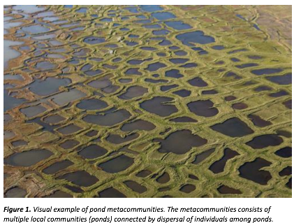
What systems might be good to study such phenomena?

Slide 49
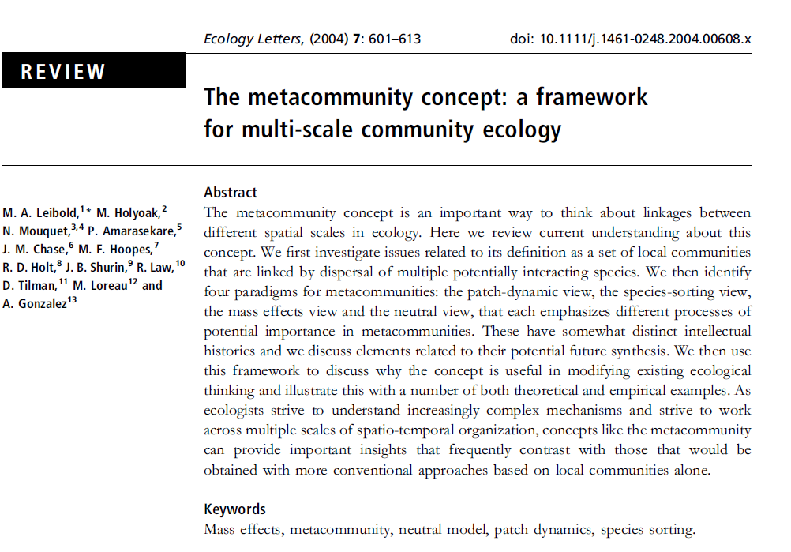

Slide 50
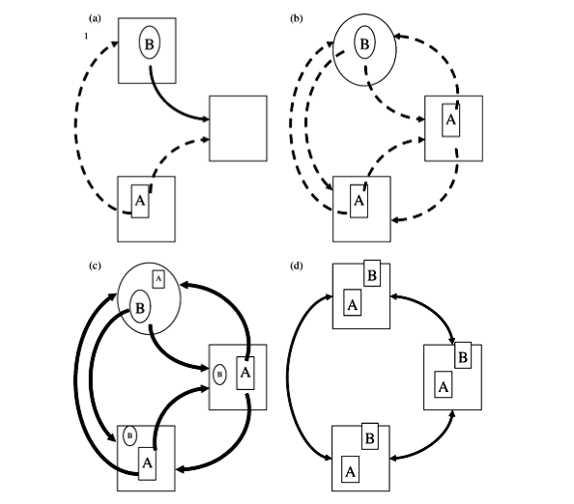
4 Metacommunity paradigms
Patch dynamics perspective
Species-sorting perspective
Mass-effect perspective
Neutral perspective
Leibold et al. 2004. The metacommunity concept: a framework for multi-scale community ecology. Ecology Letters 7: 601–613
Notes:
Four main ideas about how dispersal and environmental variation combine to shape communities.
Dashed arrows little dispersal, solid lines more dispersal..
Patch dynamics dispersal limited and can be empty patches - diversity low
Species sorting – moderate dispersal env important but dispersal required to keep diversity higher as env varies
Mass effects – dispersal overwhelms env variation – taxa can be rescued from local competitive exclusion by constant immigration
Neutral model – perspective in which all species are similar in their competitive ability, dispersal and fitness. Population interactions among species consist of random walks that alter relative frequencies of species

Slide 51
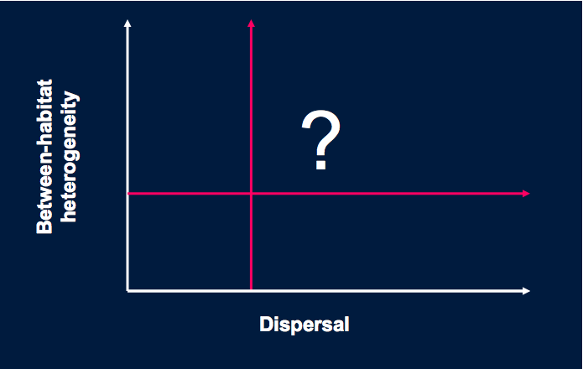
So we have a framework for conceptualising role of dispersal – great..
Notes:
Where do the different paradigms lie on these axes?

Slide 52
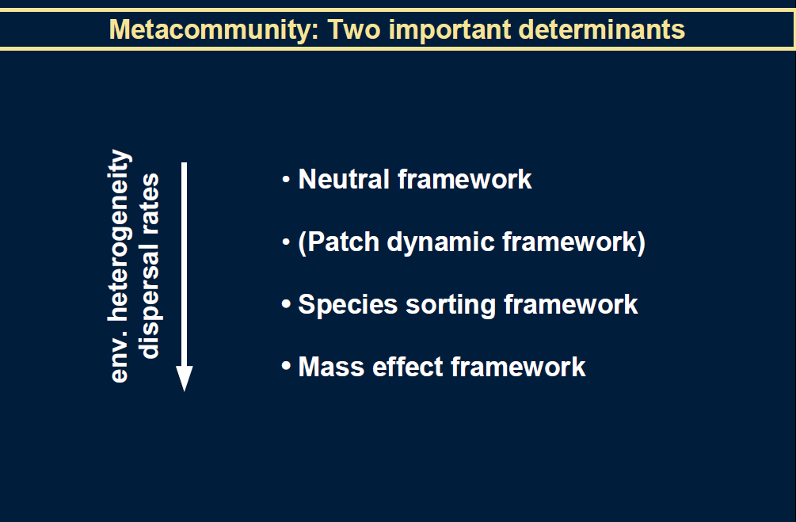

Slide 53
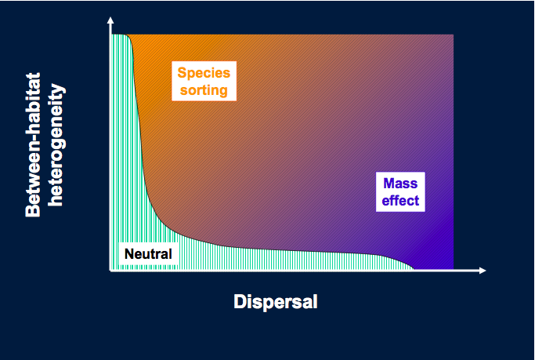
Notes:
Difficult to fit patch dynamics into this model as it assumes that all patches are homogenous.

Slide 54
Theory is great/beautiful/simple

Slide 55
Ecological Data are generally very dirty/ugly/complex

Slide 56
So how do we deal with complexity?
Simplify
Heuristic methods to help us reduce dimensions of data
For multivariate data – ordination
Univariate data - models

Slide 57
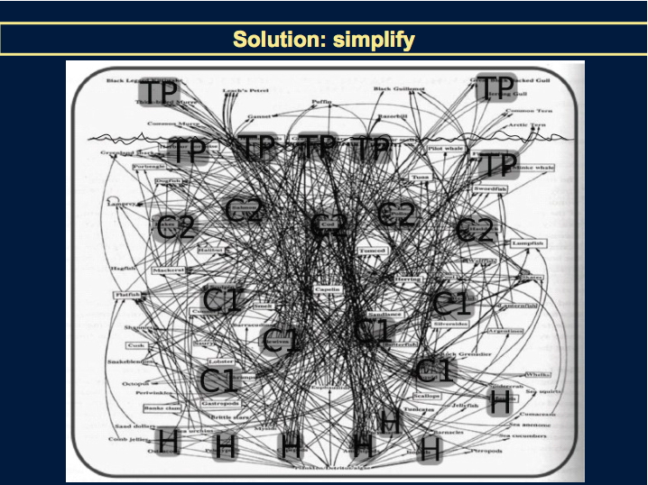

Slide 58
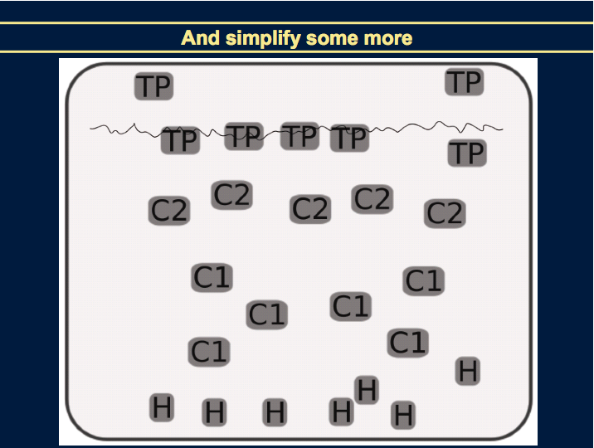
Notes:
This will link to the talks on ordination and ideas on PCNM

Slide 59
Methods employed
  Community distance metrics (e.g. Bray-Curtis dissimilarities) along spatial and environmental gradients
  Mantel and partial Mantel Test – comparing ecological distance, environmental distance and geographic distance
Most common methods are ordination
All means of reducing complexity to make it analyzable.

Slide 60
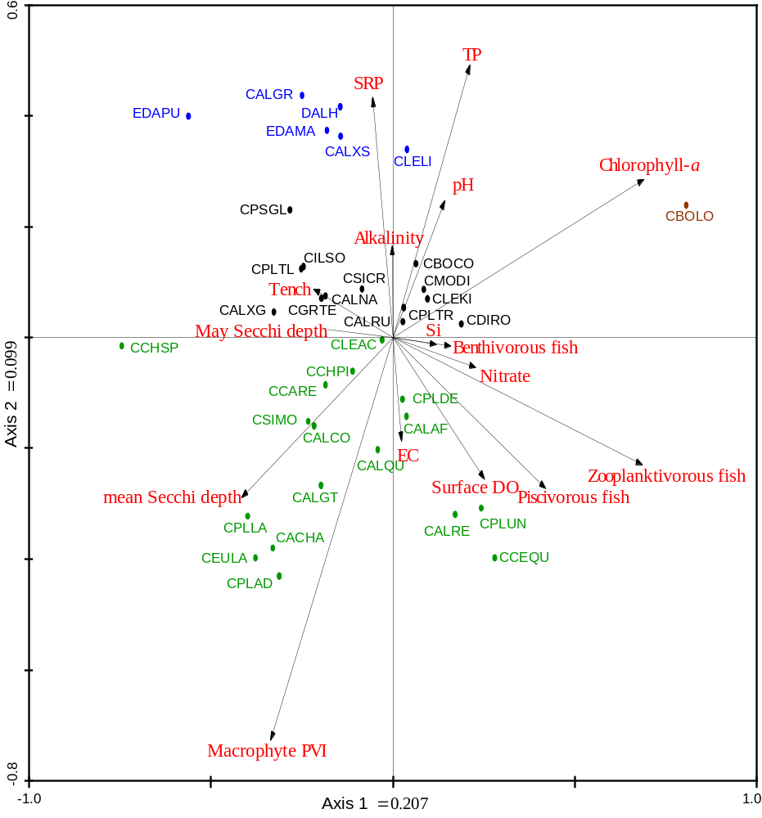
Example of an ordination bi-plot
Notes:
Reduced the complexity of a multidimensional matrix of species composition to a set of axes scores – which are a model – a heuristic device to help understand the relationship between assemblage structure and the forces that control it.

Slide 61
Statistical techniques
Variation partitioning analysis (Borcard et al. 1992 – 2159 citations on google scholar)
  Partition the explained variation of in assemblage data – abundance or presence/absence into unique and common fractions
  CCA and RDA partition the variation between environment and space
  Env descriptors easy – as long as you measure the right ones
  Space descriptors have developed over the past 20 years or so (see Legendre ppt if time)
  Principal coordinates of neighbourhood matrices (PCNM) – is one such technique

Slide 62
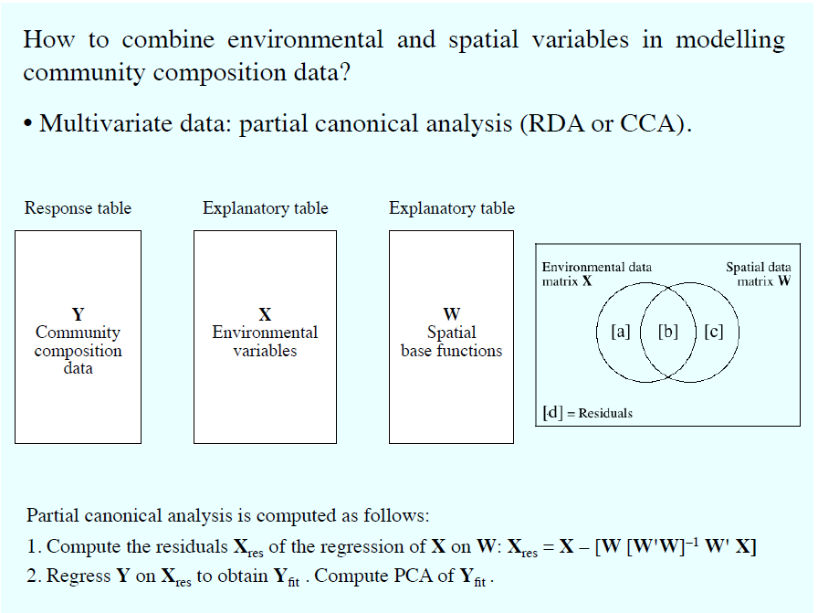
Variance partitioning

Slide 63
Spatial variation
Gradients / Trends
Patchy / Clumped patterns
Linear geographic location
Source: Borcard et al. (2002) Ecol.Model. 153:51+
Notes:
So in representations of space used in analysis it is important to represent all these different types of variation.
This links to the PCNM analysis we will do later
…

Slide 64
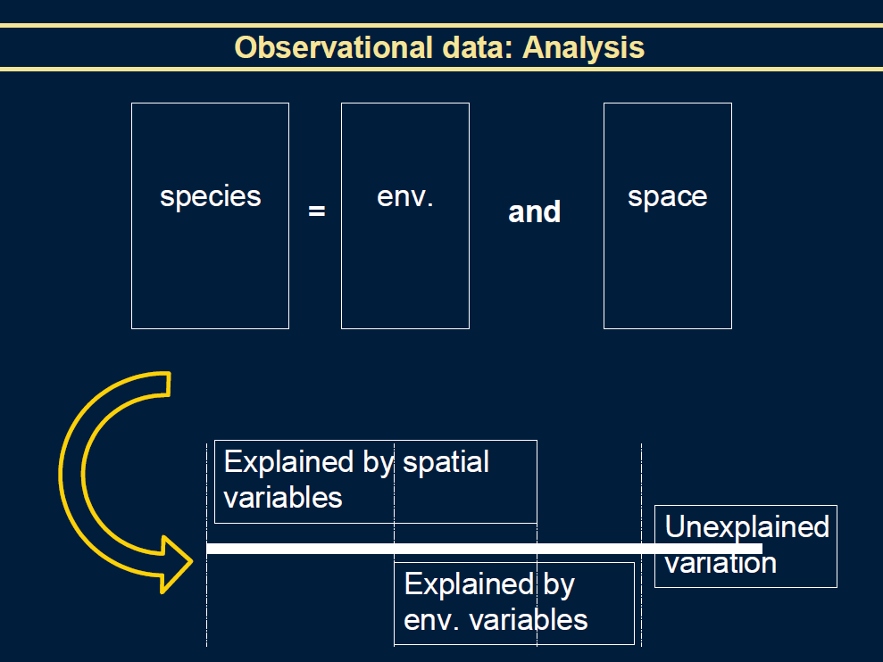
Notes:
So how can the metacommunity theory be used in real world studies and why?

Slide 65
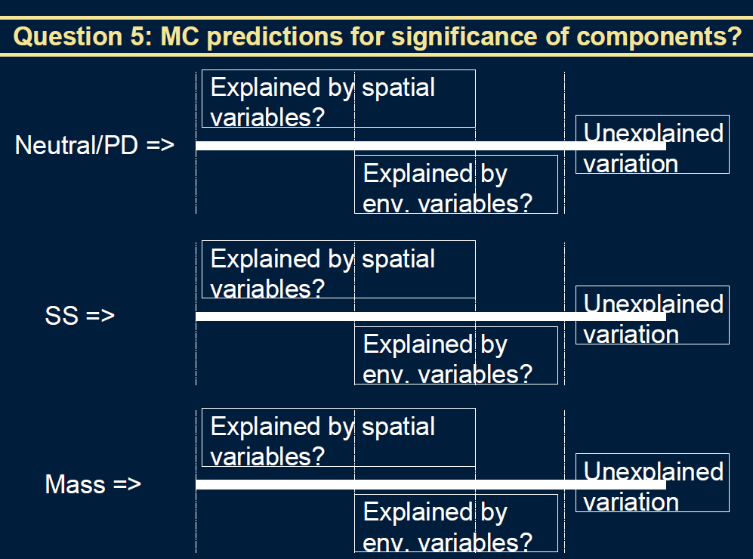

Slide 66


Slide 67


Slide 68


Slide 69

Notes:
Key assumptions of this approach is that environment is well characterised..

Slide 70

Lake metacommunites?

Slide 71

Lake metacommunites?

Slide 72

Pond metacommunities?

Slide 73


Slide 74


Slide 75

Pond metacommunities (De Bei et al. 2012)

Slide 76

Pond metacommunities (De Bei et al. 2012)

Slide 77
Problems with the method
Some simulation models say inflated type I error Gilbert & Bennet 2010. J Applied Ecology
Legendre et al. state the opposite?? Is robust and good representation
My problem - missing env or biotic variables that have a spatial stucture and what happens to that variance?

Slide 78

Long-term changes linked with eutrophication and dispersal in shallow lakes metacommunities
Jorge Salgado
^{c}Carl Sayer, ^{c}Thomas Davidson, ^{b}Stephen Brooks, and ªBeth Okamura
a Department of Zoology, Natural History Museum, Cromwell Road, London, SW7 5BD. ,
b Department of Entomology, Natural History Museum, Cromwell Road, London, SW7 5BD. ,
c Environmental Change Research Centre, Department of Geography, University College London, Gower Street London, WC1E 6BT
Salgado et al. (in prep)

Slide 79

Upper Lough Erne (ULE) system

Slide 80



Recurrent floods

Slide 81

Lough Erne Drainage
Pre-1890
High floods (main Lough water-levels > 157 ft)
1880-1890 Major drainage schemes (main Lough water-levels < 153 ft)
1950-1960 Hydroelectric power station + drainage (main Lough water-levels = 145-147 ft)
Improved channels shown in black
Price, J. (1890) Min Proc Civil Eng (2451): 74-96

Slide 82

Eutrophication

Slide 83

Historical inferred enrichment curve
50 years
Dredging
50 years
Dredging
50 years
Battarbee, (1986) Proc.R.Ir.Acad v.ol.86B,141-168

Slide 84





Organisms sampled
Macrophytes
Bryozoans
Chironomids
Molluscs
Cladocerans
Mites
Salgado et al. (in prep)

Slide 85

Metacommunity perspectives
(Cottenie 2005. Ecol Letters)

Slide 86


pRDA results
Aerial
Flow
Species sorting +Mass effects

Slide 87
Selected lakes & sampling methods
PALEO-DATA
  4 satellite (blue)
  ULE (green)
    Differ in chemistry (30 – 380 ugm TP) & connectivity
  Radiometric dating
  c. 150 years
X
Notes:
Sediment cores taken from these five sites

Slide 88





Slide 89

Examples of macrofossil remains

Slide 90
Organisms sampled
Macrophytes
Bryozoans
Chironomids
Molluscs
Cladocerans
Mites
Salgado et al. (in prep)

Slide 91

Brodersen et al.(2001) Freshwat Biol
Distinct changes in chironomid communities reflect the eutrophication process
The current hypertrophic state (reduced benthic primary production) is indicated by mud-dwelling chironomid taxa
Macrophyte succession through Chara, Ceratophyllum and Potamogeton dominance to the present state, with complete loss of submerged vegetation and dominance by phytoplankton.

Slide 92

Spatial-temporal turnover
Macrophytes
Invertebrates
Chironomids
Dispersal assumptions
Macrophytes: compete for space, tolerance rather than escaping
(low-intermediate disperses).
Invertebrates: Diverse group (intermediate disperses)
Chironomids: large numbers, fly (high dispersers).

Slide 93

Macrophyte community change through time – what does it mean?
Information on functional traits linked to dispersal, based on Barrat-Segretain 1996, Willby, Abernethy & Demars (2000) and Capers et al. 2011. Selected dispersal traits were: mode of reproduction (sexual or asexual), number of reproductive organs per year, dispersal vector and growth form (anchor vs. unrooted)

Slide 94

Working scenarios

Slide 95
Working scenarios

Slide 96
Summary
Dispersal and eutrophication are key community structuring factors in the system.
Dispersal has buffered eutrophication over time by maintaining poor competitors.
Paleo-record suggest however, that if continuing, eutrophication will overcome dispersal.
The use of a range of taxa that differ in dispersal potential “can be used” as a surrogate of dispersal over time (more work is needed!).
A regional scale approach is necessary for better understanding of eutrophication in well-connected systems.

